Slide 1
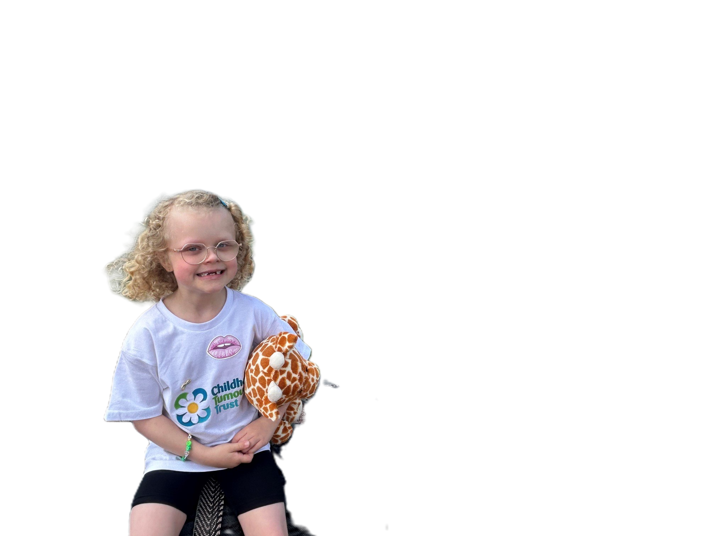


Understanding
Neurofibromatosis Type 1 (NF1)
NF1
Understand
Support
Include
Supporting children in:
Primary Schools
A practical resource to help primary school staff understand how NF1 may affect:
✓ Learning
✓ Attention and organisation
✓ Communication
✓ Physical activities
✓ Friendships and confidence
✓ Attendance and wellbeing
All photographs feature children with NF1
and are shared with the consent of their parents or guardians
.
Template made by Lauren Gowans and Ramneek Sandhu at Manchester Metropolitan University for the Childhood Tumour Trust

Slide 2

What is NF1?
A simple explanation teachers can remember
What is NF1?
✓ NF1 is a genetic condition a child is born with
✓ It can affect the skin, nerves, bones, vision, learning and development
✓ NF1 affects every child differently
✓ Some children may have very few difficulties
✓ Others may need additional support at different stages
✓ NF1 is not contagious
Instead of asking:
“What should a child with NF1 be able to do?”
Ask:
“How does NF1 affect this individual child, and what support do they need?”
Instead of asking:
“What should a child with NF1 be able to do?”
Ask:
“How does NF1 affect this individual child, and what support do they need?”
Understanding how NF1 may affect an individual child can make a significant difference to their school experience

Slide 3
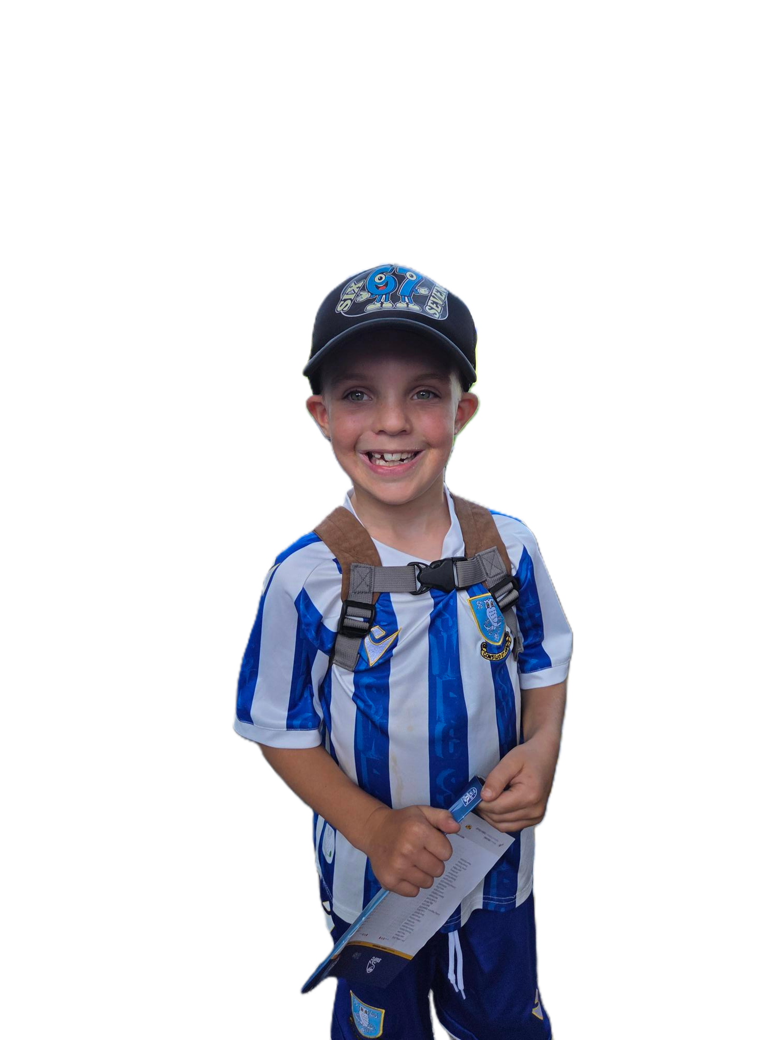
Rather than asking:
“Why can’t this child do this yet?”
Consider asking:
“What support might help this child develop this skill?
Common classroom-related areas
to be aware of
May take longer to want to say. to say.
Executive functioning
Processing speed
NF1 can show up in different ways
May struggle with planning, organisation, remembering equipment, starting tasks or following several st
May understand the work but need longer to process instructions, answer questions or complete tasks.
Attention
Social & emotional development
These are possible areas to notice — not a checklist every child will match.
May find it difficult to stay focused, particularly during longer explanations or independent work.
May find friendships, joining in, managing emotions or coping with change more challenging.
Visual-spatial skills
Fatigue, pain & sleep
May find diagrams, handwriting layout, maths, copying from the board or judging space more challenging..
Some children with NF1 experience fatigue, headaches, pain or sleep difficulties, which may affect concentration, behaviour and learning during the day.
Gross motor skills
Reading, writing & maths
May have difficulties with balance, coordination, running, climbing or other physical activities
Some children may experience specific difficulties with literacy, numeracy, spelling or written expression.
A child with NF1 may not be behind simply because they have missed school. They may learn differently and need teaching strategies that reflect their individual needs.

Slide 4

What teachers might notice
Possible signs in everyday school life
Possible signs in everyday school life
✓ Takes longer to follow instructions
✓ Finds transitions difficult
✓ Tires more easily
✓ Avoids some physical activities
✓ Finds handwriting or pencil control difficult
✓ Needs extra reassurance
✓ Produces less written work than their verbal understanding suggests
✓ May find joining in with other children difficult
Instead of asking
"Why won't they join in?“
Ask
"What might be making this difficult?
Look beyond the behaviour. What appears to be reluctance, lack of effort or poor concentration may be a child experiencing a genuine barriers.

Slide 5

Communication
Helping every child understand, express themselves and feel heard
Some children with NF1 may:
✓ Have delayed speech or language development
✓ Take longer to understand what has been said
✓ Need instructions repeated or broken into smaller steps
✓ Find it difficult to put their thoughts into words
✓ Need extra time to answer a question
✓ Speak very quickly or talk at length without recognising when others want to speak
✓ Find conversational turn-taking difficult
✓ Struggle to follow conversations in a busy classroom
Rather than asking:
“Why aren’t they listening?”
Consider asking:
“What could I change to make it easier for this child to understand, communicate and be understood?”
Communication is not only about speaking; it is about being able to understand, express yourself and feel understood.

Slide 6
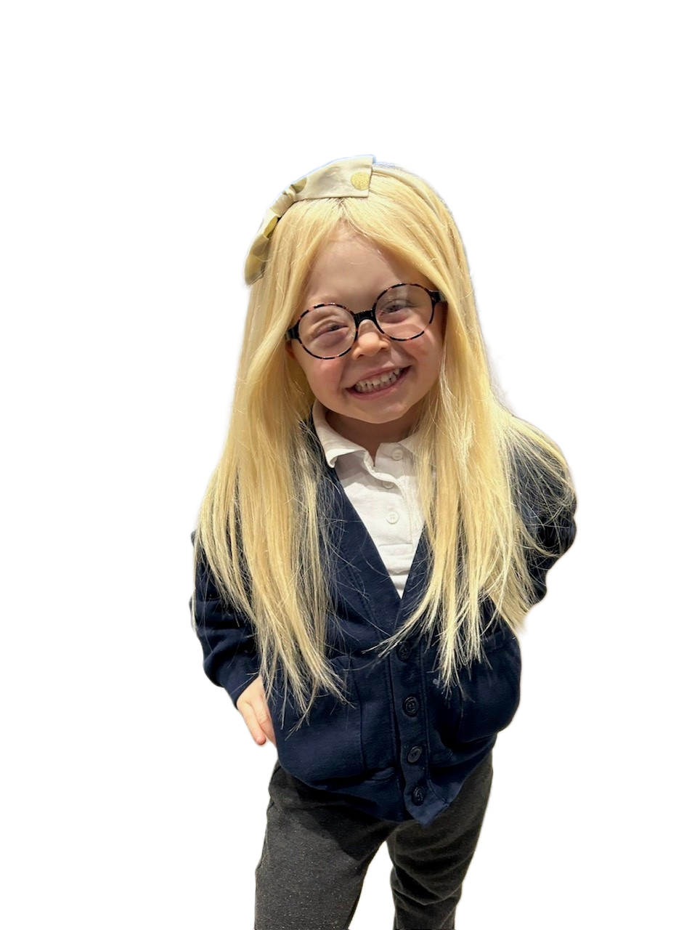
ATTENTION & EXECUTIVE FUNCTIONING
Helping children focus, organise and get started
Some children with NF1 may:
✓ Become easily distracted
✓ Forget instructions soon after hearing them
✓ Find multi-step instructions difficult
✓ Know what they need to do but need help to get started
✓ Need prompting to begin a task independently
✓ Lose equipment or forget what they need
✓ Find changing between activities difficult
✓ Start work but struggle to finish it
✓ Become overwhelmed when given too much information at once
Instead of asking:
"Why aren't they concentrating?“
Ask:
"How can I make this task easier to follow and manage?"
What looks like not listening, carelessness or lack of effort may actually reflect difficulties with attention, memory or executive functioning.

Slide 7

FINE & GROSS MOTOR SKILLS
When movement and everyday school activities are more difficult
Some children with NF1 may:
✓ Find pencil control, drawing or colouring difficult
✓ Struggle with scissors or other small tools
✓ Take longer with buttons, zips or getting dressed
✓ Find running, jumping or hopping more difficult
✓ Have difficulties with balance or coordination
✓ Avoid climbing or some playground equipment
✓ Tire more quickly during physical activities
✓ Become frustrated when their body cannot keep up with what they want to do
✓ Find using cutlery independently difficult
✓ Tumours may sometimes cause pain, weakness or restrict movement, depending on where they are located
Rather than asking:
“Why are they struggling?”
Consider asking:
“Is the activity physically harder for this child, and how could I adapt it?
.
Physical difficulties may be related to coordination, fatigue, pain or the effects of tumours. Adapt activities to help the child participate safely rather than assuming they are unwilling to join in.

Slide 8
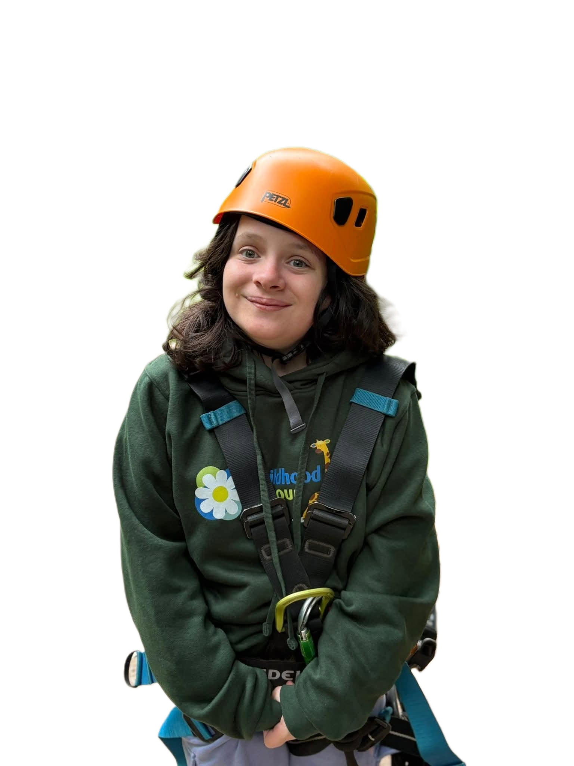
FATIGUE, PAIN & HEALTH
When NF1 affects the school day
Some children with NF1 may:
✓ Tire more quickly than their classmates
✓ Experience pain or headaches
✓ Have difficulties sleeping
✓ Have days when concentration is much harder
✓ Need rest or movement breaks
✓ Attend regular hospital appointments
✓ Need time away from school for investigations or treatment
✓ Find returning after an absence difficult
Instead of asking:
"Why can't they keep up today?“
Ask:
"Could fatigue, pain or their health be affecting them today?"
A child's needs can vary from day to day. Flexibility allows them to continue learning without having to push through pain or fatigue..

Slide 9

MISSING SCHOOL & CATCHING UP
Absence may only be part of the picture
A child with NF1 may:
✓ Miss school for appointments, scans or treatment
✓ Return tired after hospital visits
✓ Miss important building blocks of learning
✓ Feel overwhelmed by a pile of catch-up work
✓ Need key concepts retaught rather than simply being given missed worksheets
✓ Have underlying learning differences as well as absence
✓ Need additional time and support to consolidate learning
Instead of saying:
"You just need to catch up.“
Ask:
"What have you missed, and what support will help you understand it?"
More work is not always the answer. Prioritise essential learning and make sure the child understands it before expecting them to move on.

Slide 10
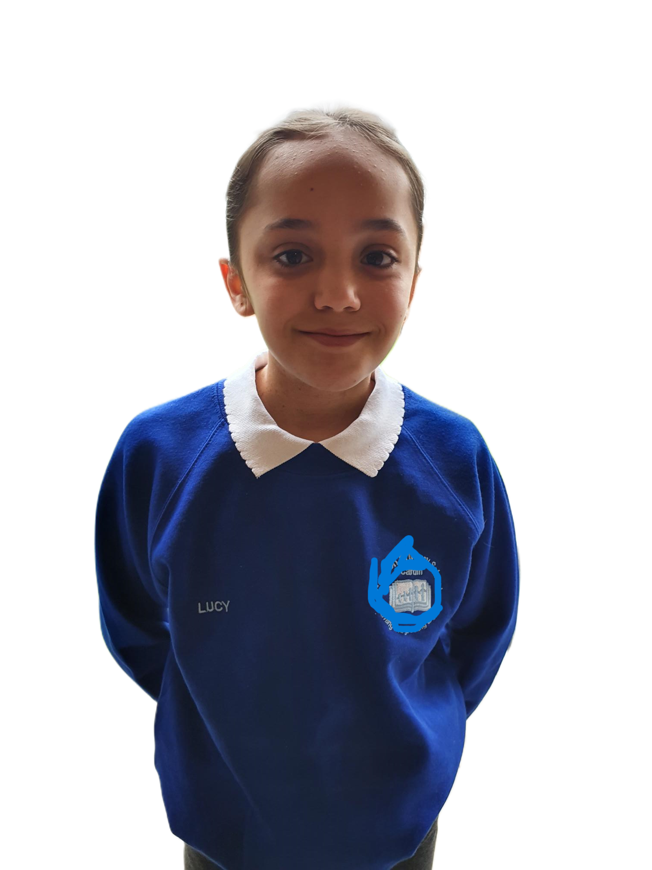
ATTENDANCE & INCLUSION
When absence is unavoidable.
For some children with NF1:
✓ Hospital appointments, scans and treatment may mean unavoidable absence
✓ They may need time away from school for surgery or recovery
✓ Some children may already worry about falling behind their classmates
✓ They may work extremely hard to keep up despite their health needs
✓ 100% attendance awards can exclude them for circumstances completely outside their control
✓ Watching classmates receive recognition they can never achieve may leave them feeling disappointed or different
✓ It can unintentionally send the message that simply being present is valued more highly than the effort they make when they are able to attend
Instead of asking:
"How can we reward 100% attendance?“
Consider asking:
"How can we recognise commitment and effort in a way that every child has a fair opportunity to achieve?"
A child should never feel that their medical condition makes them less deserving of recognition. Celebrate effort, progress and engagement — things every child has the opportunity to achieve.

Slide 11
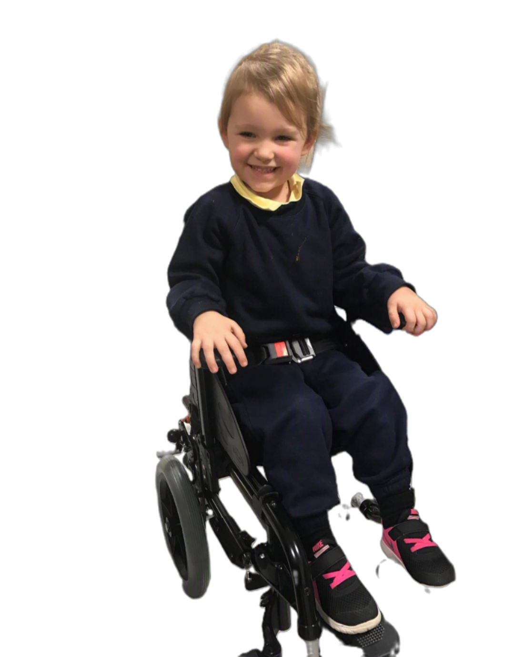
VISIBLE DIFFERENCES & PHYSICAL CHANGES
Helping children feel accepted, confident and included.
A child with NF1 may:
✓ Have café-au-lait marks that are noticeable to others
✓ Have visible neurofibromas or a plexiform neurofibroma
✓ Have differences in their face, body or limbs related to NF1
✓ Have scarring following surgery or treatment
✓ Have had an amputation because of complications associated with NF1
✓ Wear a back brace because of spinal problems such as scoliosis
✓ Wear specialist footwear or orthotics because of bone or mobility problems
✓ Have reduced vision or, in some cases, significant sight loss or blindness
✓ Experience staring, questions, comments or exclusion because they look different
✓ Feel self-conscious or worry about being treated differently
Helping classmates understand
With the child and parent/carer’s permission, consider a class discussion or school assembly to explain NF1 in an age-appropriate way. Childhood Tumour Trust has resources available to help schools do this.
Children are naturally curious about differences they may not understand. Age-appropriate information can encourage understanding, kindness and acceptance, while respecting the child’s privacy and wishes..

Slide 12
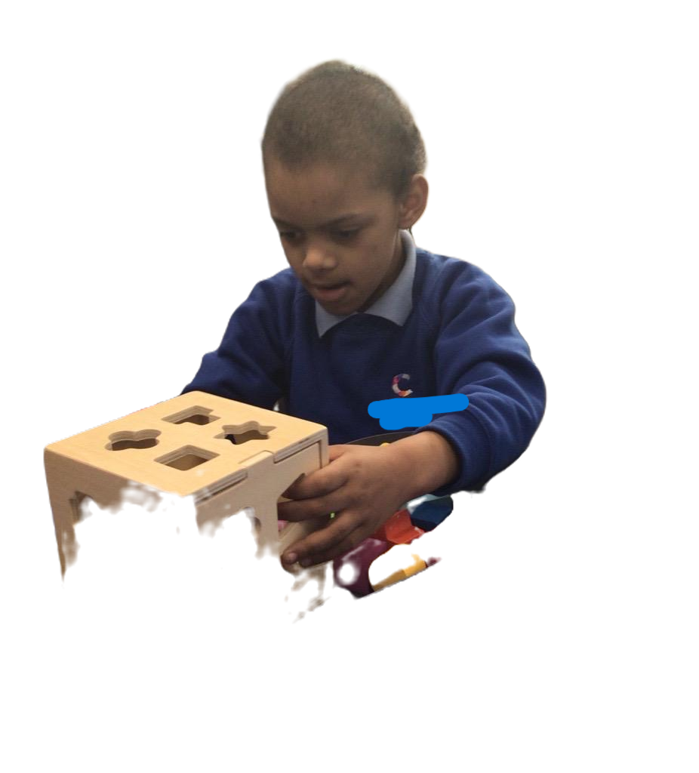
FRIENDSHIPS & SOCIAL DEVELOPMENT
Helping children feel included and connected
Some children with NF1 may:
✓ Find it difficult to join games or groups
✓ Misread social cues
✓ Find taking turns in conversation difficult
✓ Become upset when things don't go as expected
✓ Feel different because of visible signs of NF1
✓ Worry about other children asking questions
✓ Be vulnerable to teasing or exclusion
✓ Need adult support to develop friendships
.
Instead of asking:
"Why don't they play with the other children?“
Ask:
"What could help this child feel more confident and included?"
Feeling that you belong is an important part of learning. A little adult support can make friendships and school feel much easier.

Slide 13

CONFIDENCE & EMOTIONAL WELLBEING
When difficulties aren't always visible
Instead of asking:
"Why won't they have a go?“
Ask:
"What might be affecting their confidence, and how can I help them feel safe enough to try?"
Some children with NF1 may:
✓ Worry about being different
✓ Become frustrated by things they find difficult
✓ Compare themselves with classmates
✓ Avoid activities where they fear they may struggle
✓ Become anxious about hospital appointments
✓ Hide difficulties because they don't want to stand out
✓ Lose confidence after repeated struggles
✓ Need reassurance that needing support does not mean they are less capable
Repeatedly finding things harder than your peers can affect confidence. Support should remove barriers without lowering expectations.

Slide 14

CLASSROOM STRATEGIES
Small changes can make learning easier
Things That May Help
✓ Give short, clear instructions
✓ Break tasks into manageable steps
✓ Use written and visual prompts
✓ Check understanding privately
✓ Give additional processing time
✓ Provide worked examples
✓ Reduce unnecessary copying from the board
✓ Consider typing where handwriting is a barrier
✓ Use reminders and checklists
✓ Provide movement or rest breaks when needed
Instead of asking:
"Do you understand?“
Ask:
"Can you tell me what you're going to do first?"
Many adjustments that help a child with NF1 are good teaching strategies for the whole class and do not need to make the child feel different.

Slide 15
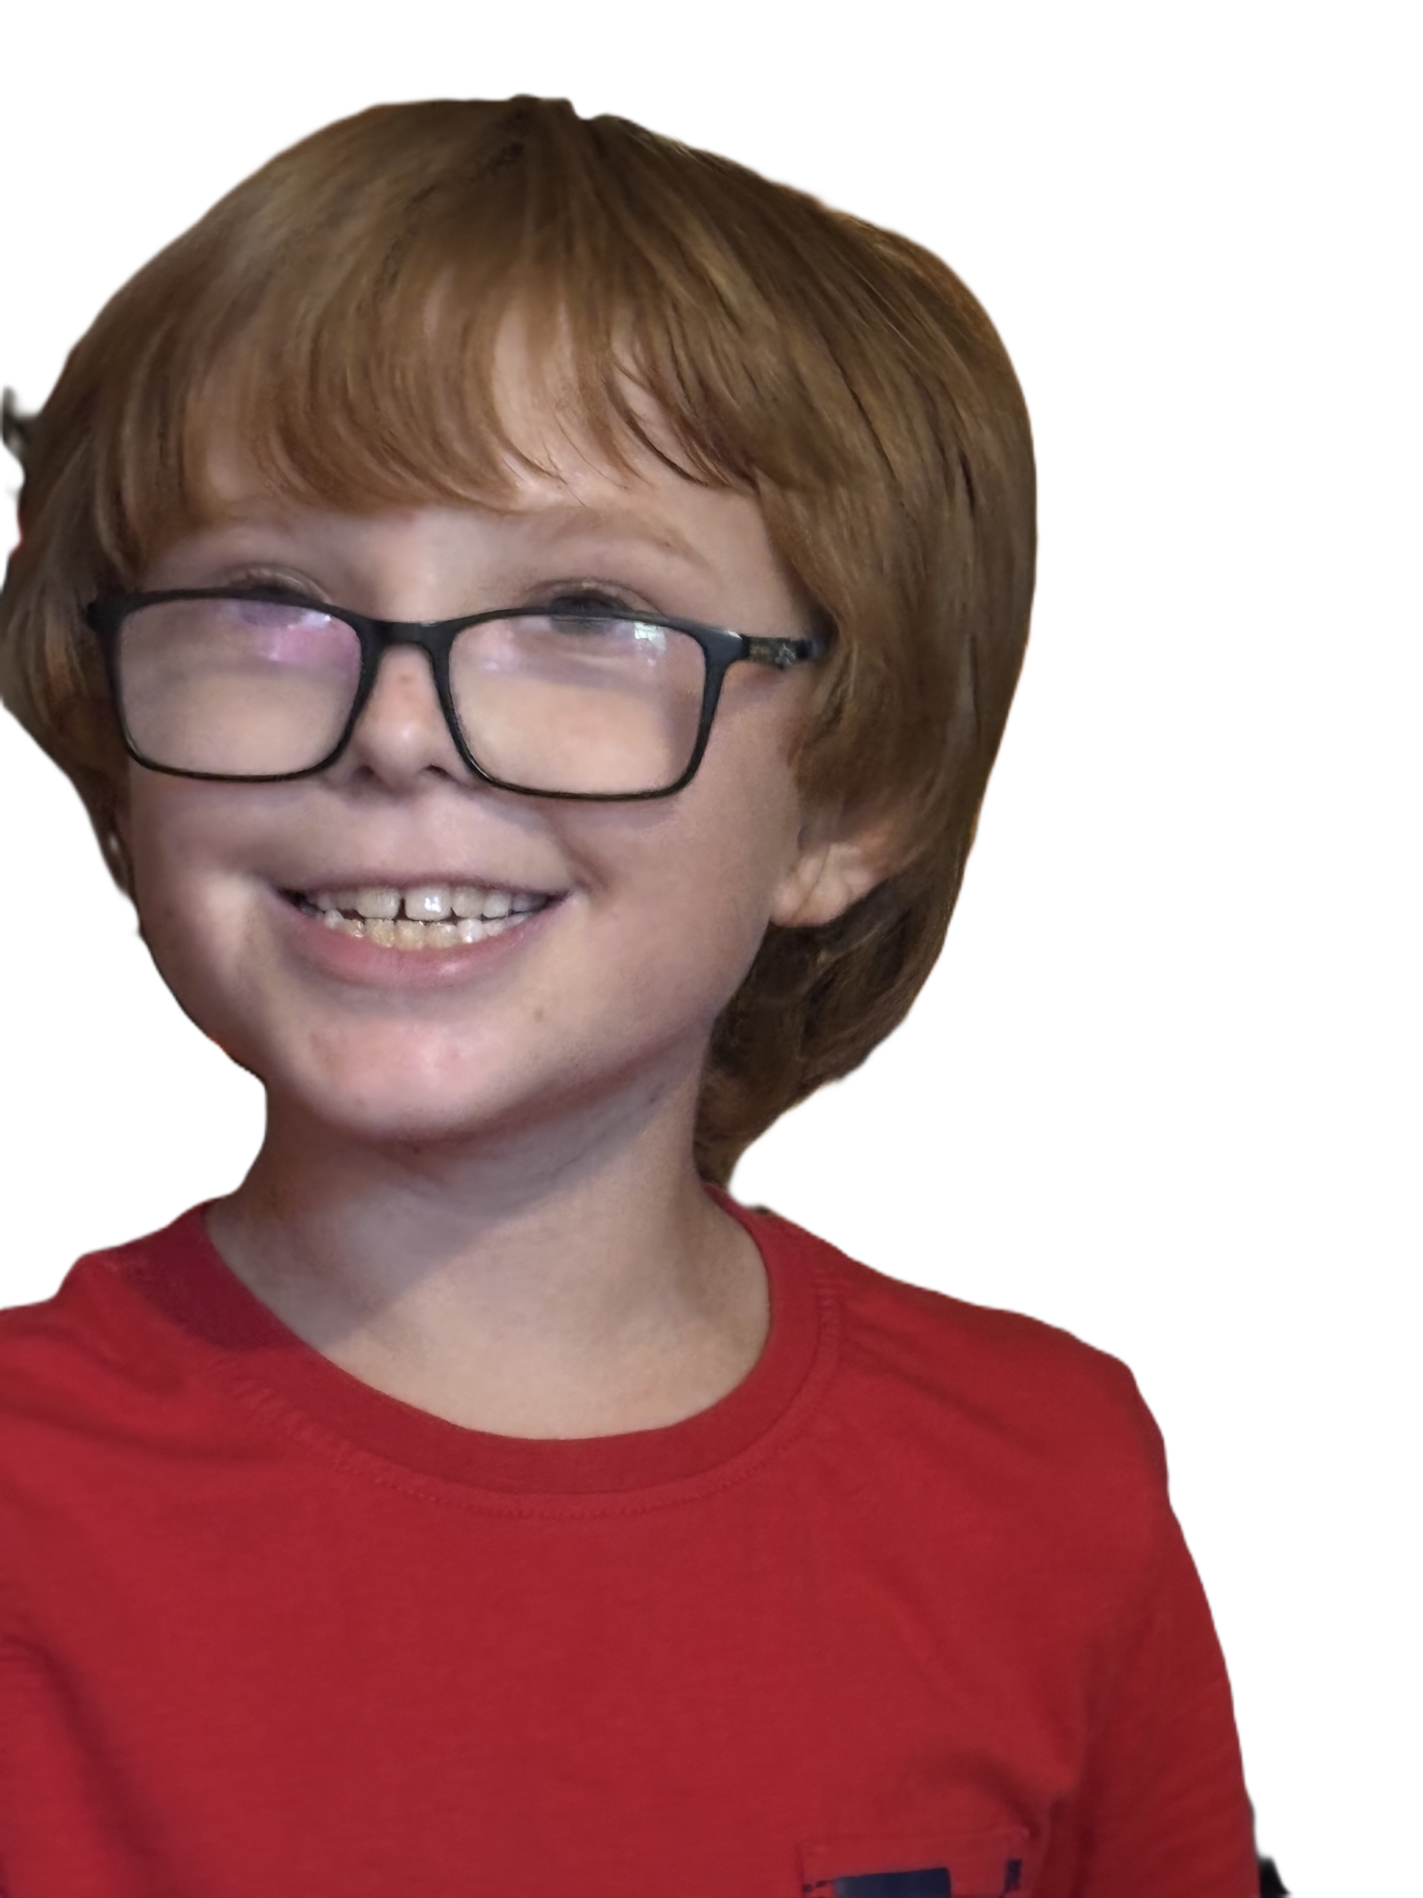
WORKING WITH FAMILIES
Parents and carers know their child best
Families Can Help You Understand:
✓ What their child finds difficult
✓ What strategies already work
✓ How NF1 currently affects them
✓ Whether fatigue, pain or sleep is affecting school
✓ Upcoming appointments or treatment
✓ Changes they have noticed
✓ Previous support that has helped
✓ Their child's strengths and interests
Rather than saying:
"Your child is struggling with...“
Consider asking:
"We've noticed this can sometimes be difficult. Is this something you've noticed at home, and what have you found helps?"
NF1 can run in families, so a parent may also have NF1 and experience difficulties with processing, attention or organisation. Keep communication clear and accessible.

Slide 16
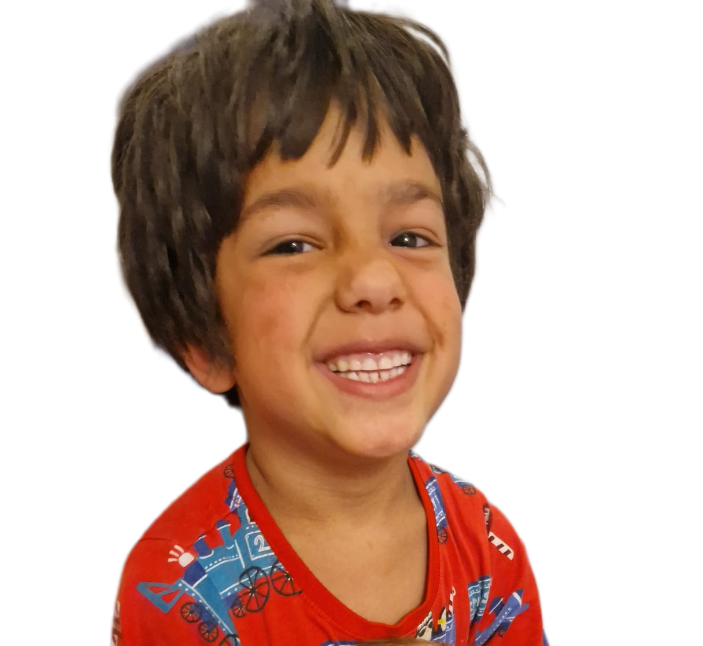
WHEN ADDITIONAL SUPPORT MAY HELP
Recognising when more support may be needed
Support might include:
✓ Reasonable classroom adjustments
✓ Targeted SEND support
✓ Additional assessment where appropriate
✓ Support from an Educational Psychologist or other professionals
✓ An Education, Health and Care Plan (EHCP), where appropriate
Not every child with NF1 will need an EHCP. Support should be based on the individual child's needs and the barriers they experience.
Instead of thinking:
"Let's wait and see if they catch up.“
Ask:
"Is there support we
could put in place now?"
Not every child with NF1 will need additional SEND support, but difficulties should not have to become severe before they are recognised.

Slide 17

STRENGTHS & POTENTIAL
See the child, not just NF1
Instead of asking:
"What can't this child do?“
Ask:
"What are they good at, and how can we build on it?"
Every Child Has Strengths
✓ Start with what they enjoy and do well
✓ Give them opportunities to succeed
✓ Celebrate effort, creativity and persistence
✓ Encourage independence
✓ Give meaningful roles within the classroom
✓ Listen to what the child says helps them
✓ Maintain high expectations
✓ Don't allow NF1 to define what you think they can achieve
Having NF1 does not determine a child's potential. The goal is to remove barriers, not lower aspirations.

Slide 18
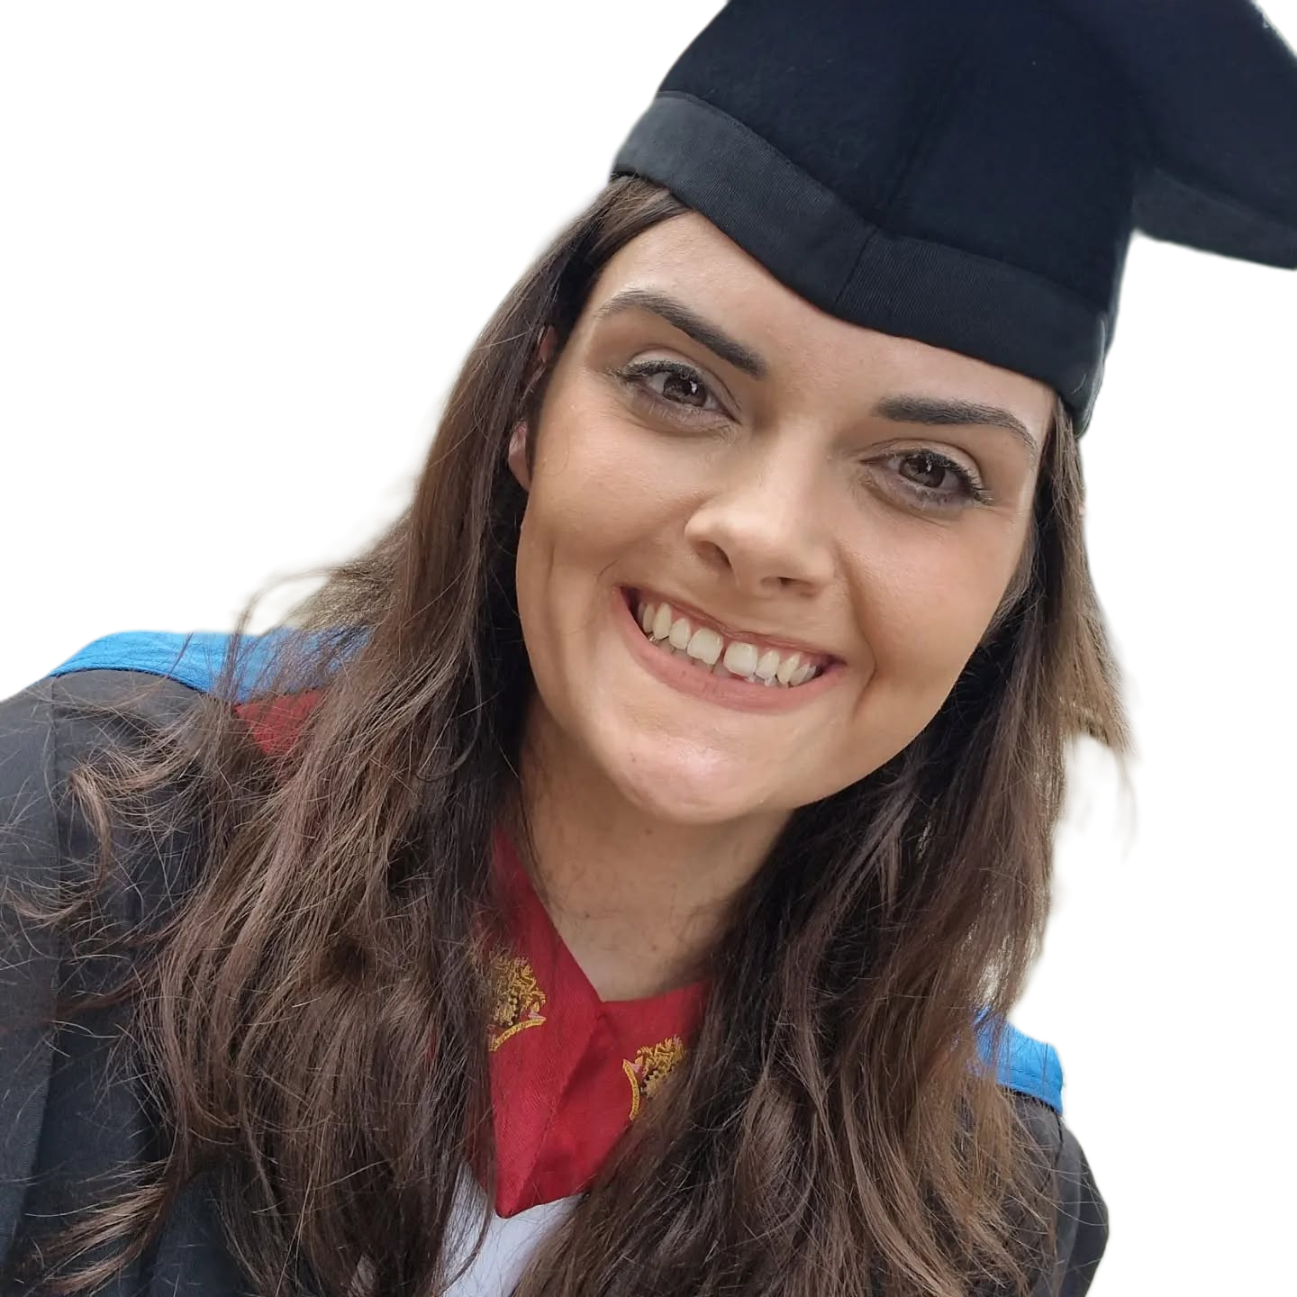
A REAL-LIFE STORY
The difference the right support can make
At six years old, she couldn't write her own name.
She struggled throughout school and was excluded from PE because of difficulties associated with NF1.
She was told she wasn't going to get anywhere.
She left school with just one GCSE.
Then she went to college and received the right support.
She achieved a Sports Diploma.
She went on to university and graduated with a:
Degree in Graphic Design Engineering
Her ability hadn't suddenly changed. What changed was the support around her — and her story is not an isolated one.

Slide 19


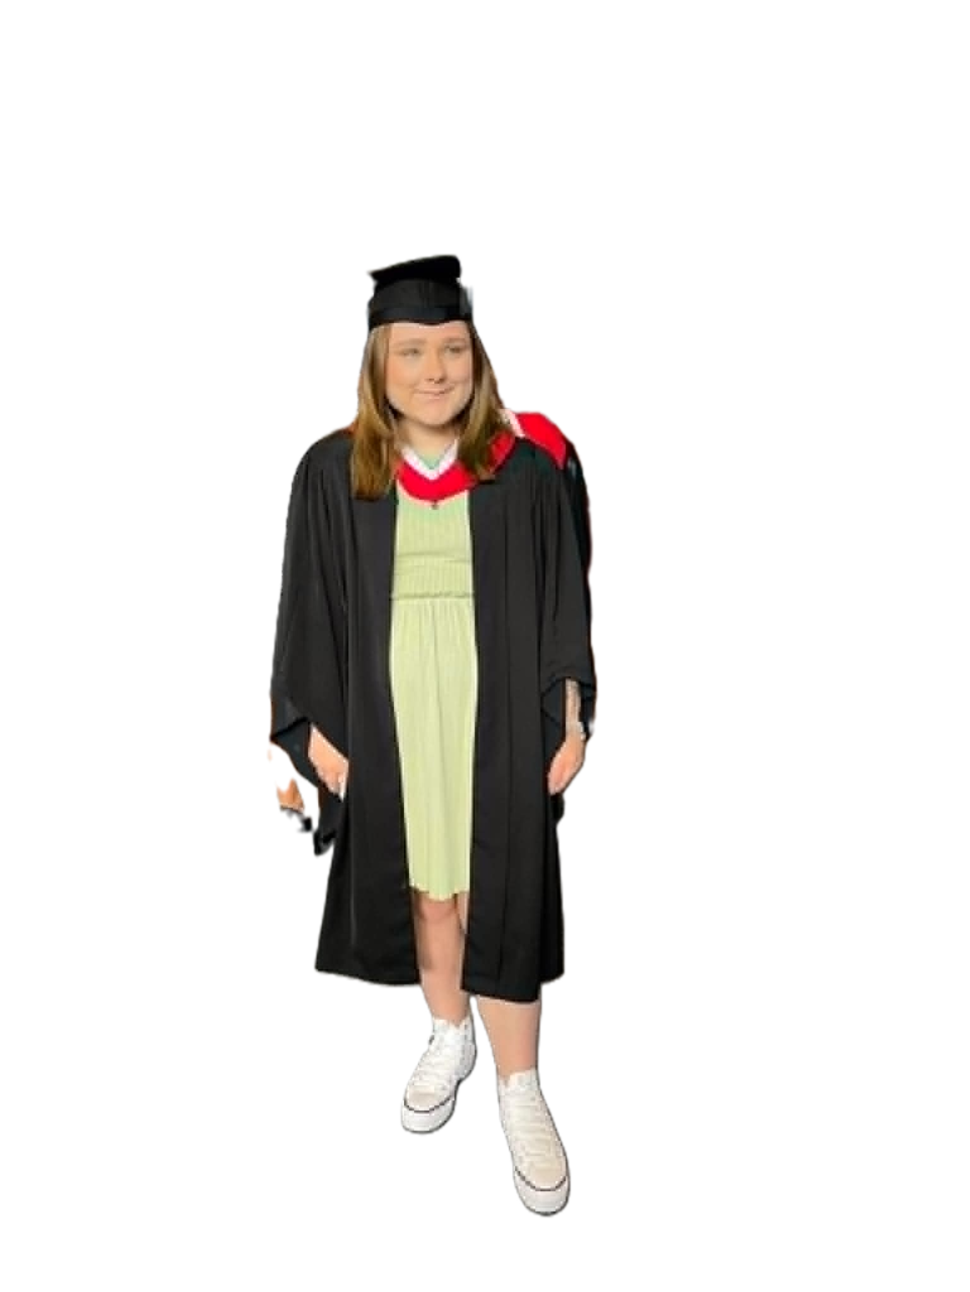
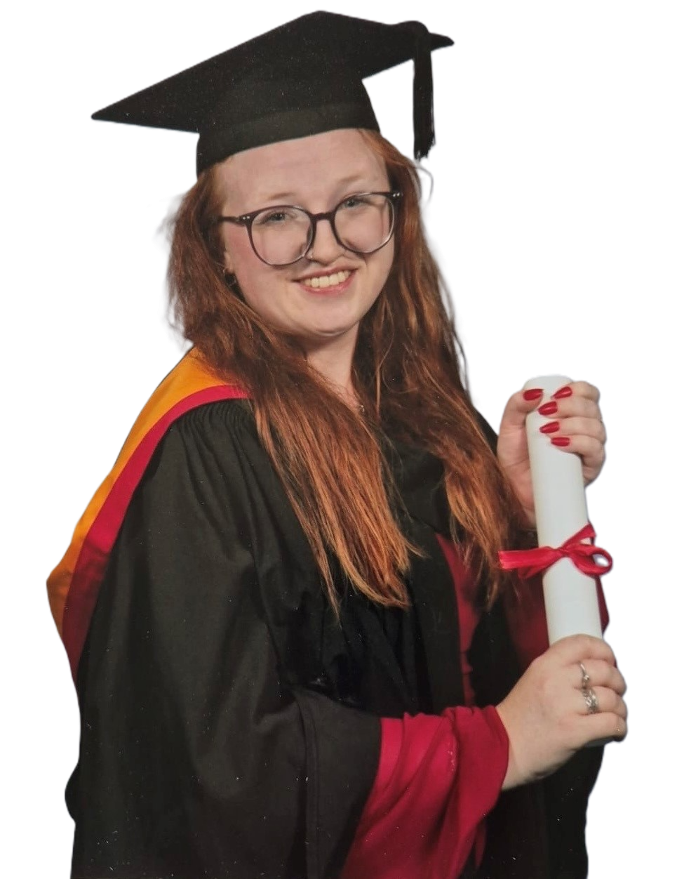
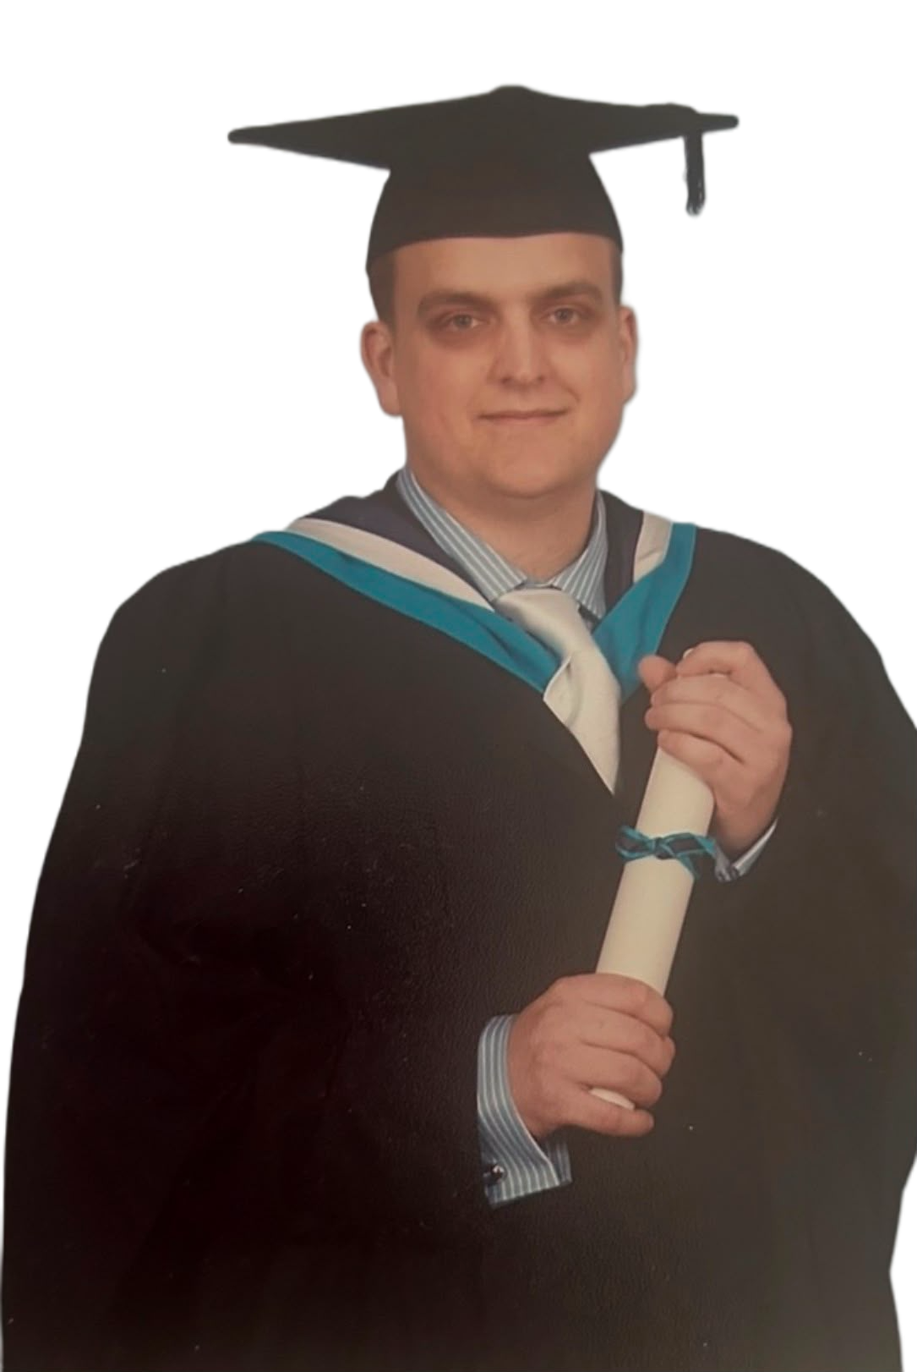
SHE IS NOT ALONE
Don't limit a child's future
These young people all have NF1
And they were all told they wouldn’t achieve academically.
Their journeys have been different, but they show why difficulties during childhood should never be used to predict what a child will achieve in the future.
Support their potential instead of limiting it.
Support their potential instead of limiting it.

Slide 20


SUCCESS LOOKS DIFFERENT FOR EVERYONE
Every child should have the opportunity to choose their own path
✓ For some, success may mean university
✓ For others, it may be college or an apprenticeship
✓ It may mean finding a job they enjoy
✓ It may mean volunteering and making a difference in their community
✓ It may mean developing confidence, friendships or greater independence
✓ It may mean discovering a talent, interest or passion
✓ Every child's strengths, ambitions and idea of success will be different
Instead of asking:
“What will this child be able to do?”
Ask:
“What can we do now to give this child as many choices as possible in the future?”
ambitions and idea of success will be different
Support their potential instead of limiting it.
The right support doesn't determine a child's destination — it gives them more opportunities to choose where they want to go..

Slide 21

WHAT EVERY PRIMARY SCHOOL TEACHER SHOULD REMEMBER
Every child should have the opportunity to choose their own path
Instead of asking:
“What will this child be able to do?”
Ask:
“What can we do now to give this child as many choices as possible in the future?”
ambitions and idea of
success will be different
✓ For some, success may mean university
✓ For others, it may be college or an apprenticeship
✓ It may mean finding a job they enjoy
✓ It may mean volunteering and making a difference in their community
✓ It may mean developing confidence, friendships or greater independence
✓ It may mean discovering a talent, interest or passion
✓ Every child's strengths, ambitions and idea of success will be different
Support their potential instead of limiting it.
Never underestimate the role you can play in the future of a child with NF1.

Slide 22
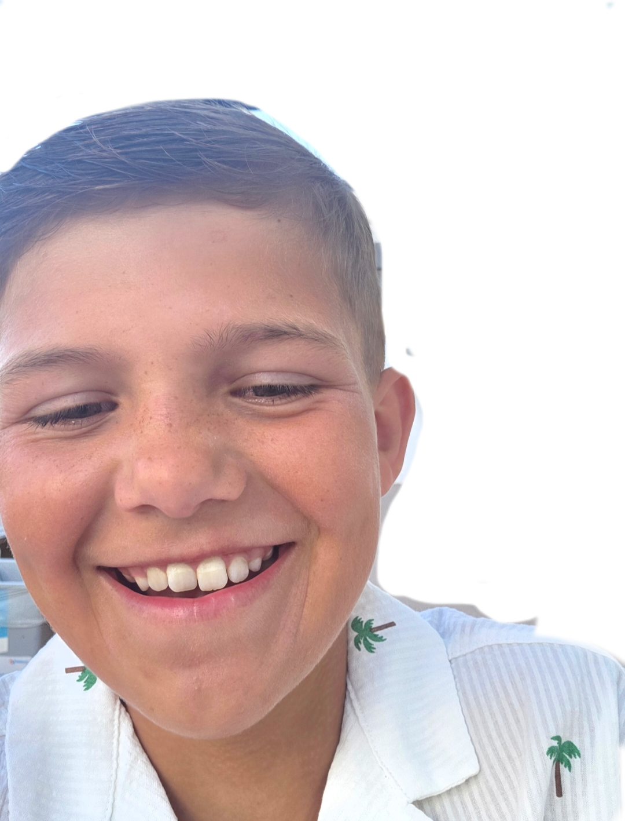

Thank you
www.childhoodtumourtrust.org.uk
info@childhoodtumourtrust.org.uk
Notes:
Introduce the session as a teacher-focused resource. Explain that the aim is not to make teachers medical experts, but to help them recognise how NF1 may affect learning, confidence, attendance and participation. Emphasise that NF1 looks different for every young person, so the most helpful approach is curiosity, flexibility and collaboration with the student, family and SENCO.

