Slide 1


Teacher Resource Storyboard
NF1
Understanding
Neurofibromatosis Type 1 (NF1)
Understand
Support
Include
All photographs feature children with NF1
and are shared with
the consent of their parents or guardians
Supporting children in:
Nurseries
Preschools
Reception
Early Years settings
.
Template made by(Lauren Gowans and Ramneek Sandhu) at Manchester Metropolitan University for the Childhood Tumour Trust
Notes:
Introduce the session as a teacher-focused resource. Explain that the aim is not to make teachers medical experts, but to help them recognise how NF1 may affect learning, confidence, attendance and participation. Emphasise that NF1 looks different for every young person, so the most helpful approach is curiosity, flexibility and collaboration with the student, family and SENCO.

Slide 2
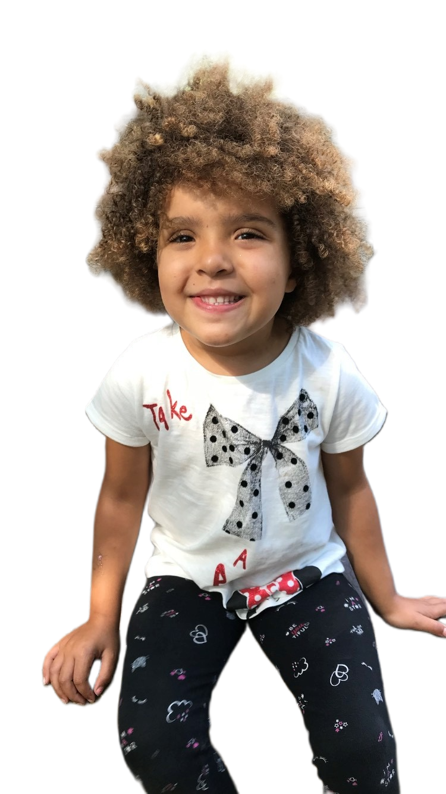
What is NF1?
A simple explanation teachers can remember
What is NF1?
NF1 is a genetic condition present from birth.
Around 1 in 2,500 people have NF1
Every child is different.
It can affect learning, movement, vision, behaviour and development.
It is not contagious.
Key message: Getting the right support in place from the beginning can make a lifelong difference for a child with NF1.

Slide 3
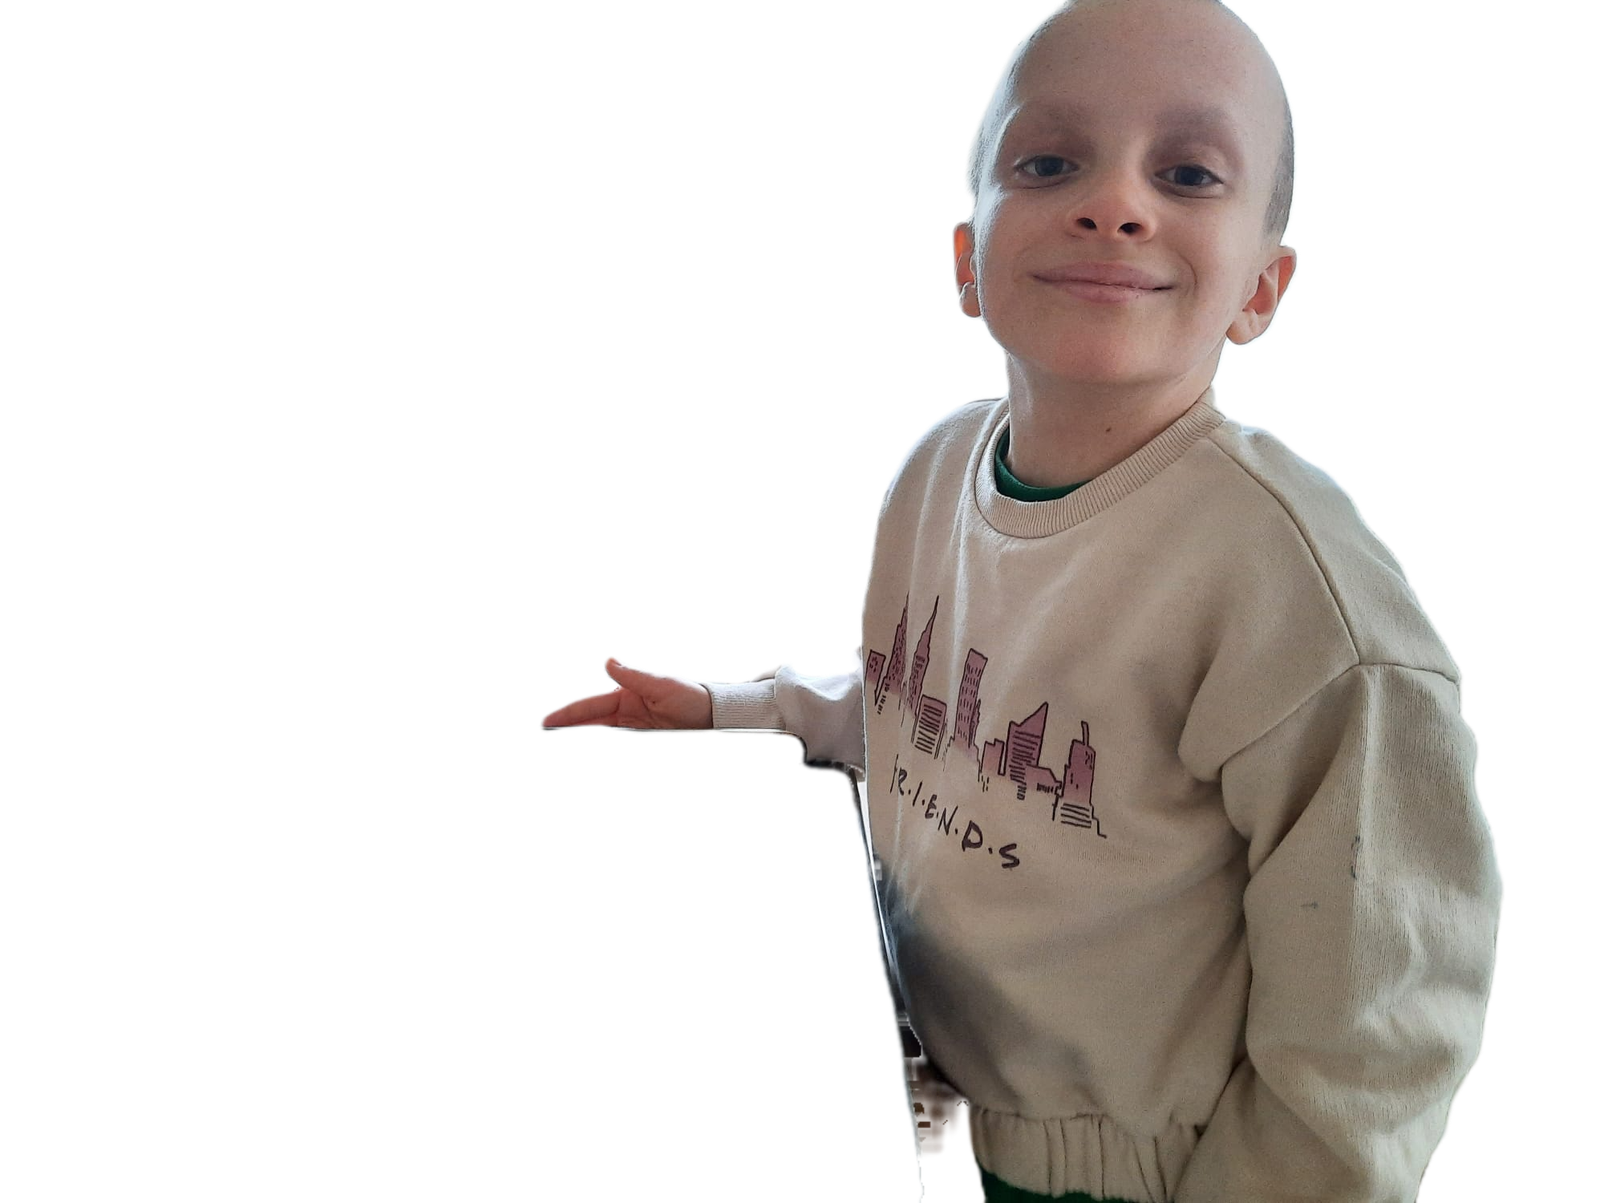
Rather than asking:
“Why can’t this child do this yet?”
Consider asking:
“What support might help this child develop this skill?
How NF1 may affect learning
May take longer to want to say. to say.
Learning & processing
Speed and Language
NF1 can show up in different ways
May need more time, repetition or visual support to understand instructions and learn new skills.
May take longer to develop speech, understand language or express what they want to say
These are possible areas to notice — not a checklist every child with NF1 will match.
Attention
Social & emotional development
May find it difficult to stay focused during stories, group activities or play
May find friendships, joining in, managing emotions or coping with change more challenging.
Fine Motor Skills
Fatigue, pain & sleep
May find drawing, pencil control, using scissors, dressing or handling small objects more difficult.
Some children with NF1 experience fatigue, headaches, pain or sleep difficulties, which may affect concentration, behaviour and learning during the day.
Gross motor skills
Key Message
May have difficulties with balance, coordination, running, climbing or other physical activities
Developmental differences can become apparent during the Early Years. Recognising them and putting appropriate support in place early can make a lifelong difference for a child with NF1

Slide 4

What teachers might notice
Possible signs in everyday school life
What Practitioners May Notice
✓ Takes longer to follow instructions
✓ Finds transitions difficult
✓ Tires more easily
✓ Avoids climbing equipment
✓ Finds pencil control difficult
✓ Needs extra reassurance
✓ Plays alongside children rather than with them
Instead of asking
"Why won't they join in?“
Ask
"What might be making this difficult?

Slide 5
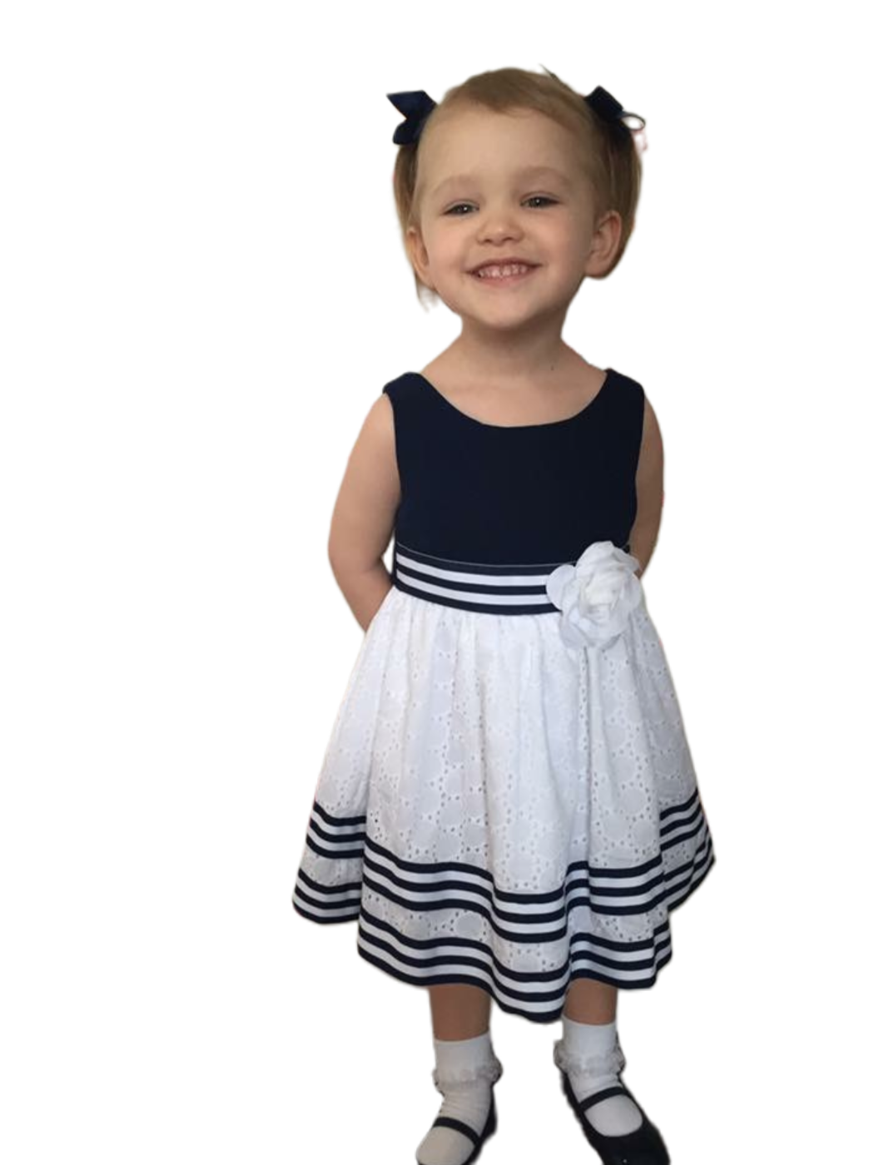
Communication
Helping every child understand, express themselves and feel heard
Some children with NF1 may:
✓ Take longer to understand what has been said
✓ Need instructions repeated or broken into smaller steps
✓ Find it difficult to put their thoughts into words
✓ Need extra time to answer a question
✓ Struggle to follow conversations in a busy environment
✓ Find group or carpet-time discussions difficult
✓ Rely on gestures or adults to help them communicate what they need
✓ Speak very quickly or talk at length without recognising when others want to speak
Rather than asking:
“Why aren’t they listening?”
Consider asking:
“What could I change to make it easier for this child to understand, communicate and be understood?”
Communication is not only about speaking; it is about being able to understand, express yourself and feel understood.

Slide 6
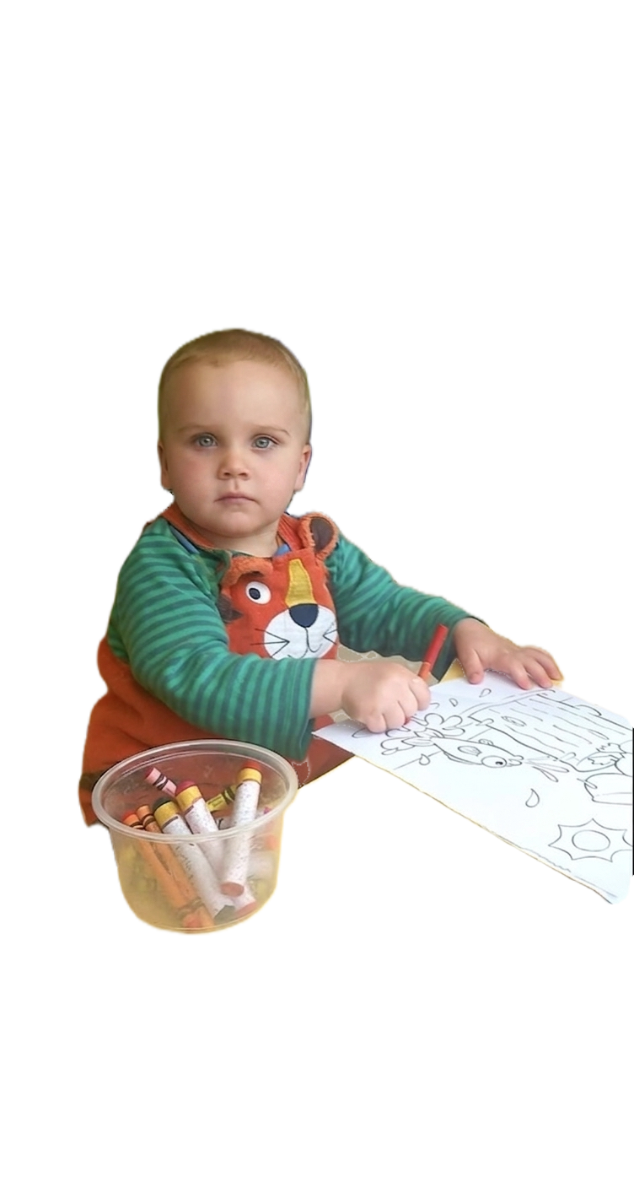
Play & Learning
Learning through play
Rather than asking:
“Why do they always choose the same activity?”
Consider asking:
“Do they feel confident trying something new, or do they need some support to get started?”
Some children with NF1 may:
✓ Prefer familiar activities rather than trying something new
✓ Need more time to understand how to play a new game
✓ Find imaginative or shared play more difficult
✓ Struggle with taking turns or waiting
✓ Move quickly between activities without finishing them
✓ Find busy or noisy play environments overwhelming
✓ Need adult support to join in with other children
Play is a vital part of learning and development. Small adaptations can help a child with NF1 participate, learn and build confidence.

Slide 7
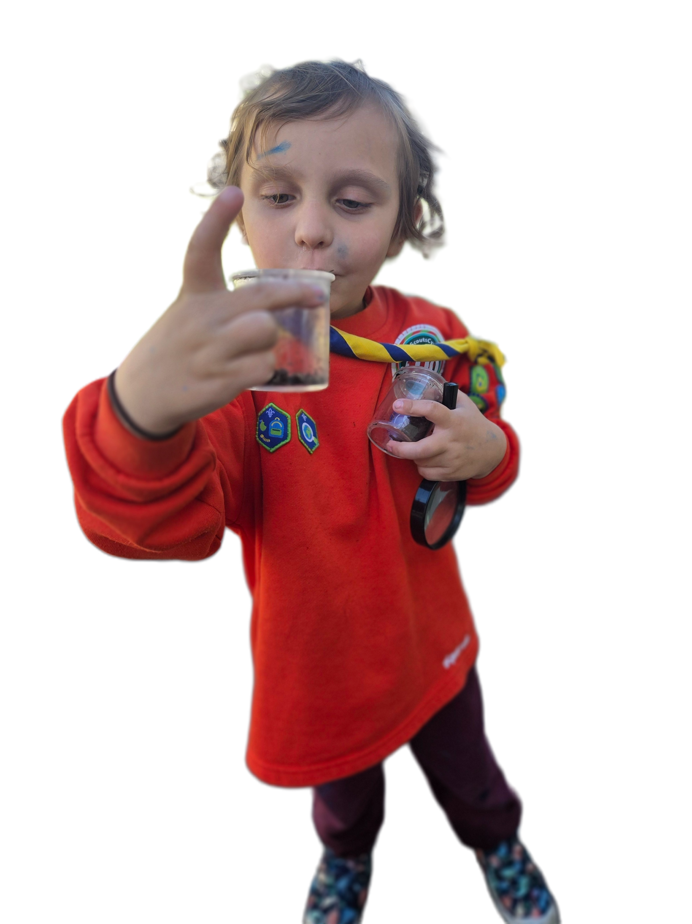
Motor Skills
How NF1 may affect everyday physical skills
Some children with NF1 may:
✓ Find pencil control, drawing or colouring difficult
✓ Struggle with scissors or other small tools
✓ Take longer with buttons, zips or getting dressed
✓ Find running, jumping or hopping more difficult
✓ Have difficulties with balance or coordination
✓ Avoid climbing or some playground equipment
✓ Tire more quickly during physical activities
✓ Become frustrated when their body cannot keep up with what they want to do
✓ Find using cutlery independently difficult
Rather than asking:
“Why aren't they trying?”
Consider asking:
“Is the activity physically harder for this child, and how could I adapt it?
.
Difficulty with a physical task does not mean a child is unwilling to participate. The right support can help them develop skills without losing confidence.

Slide 8
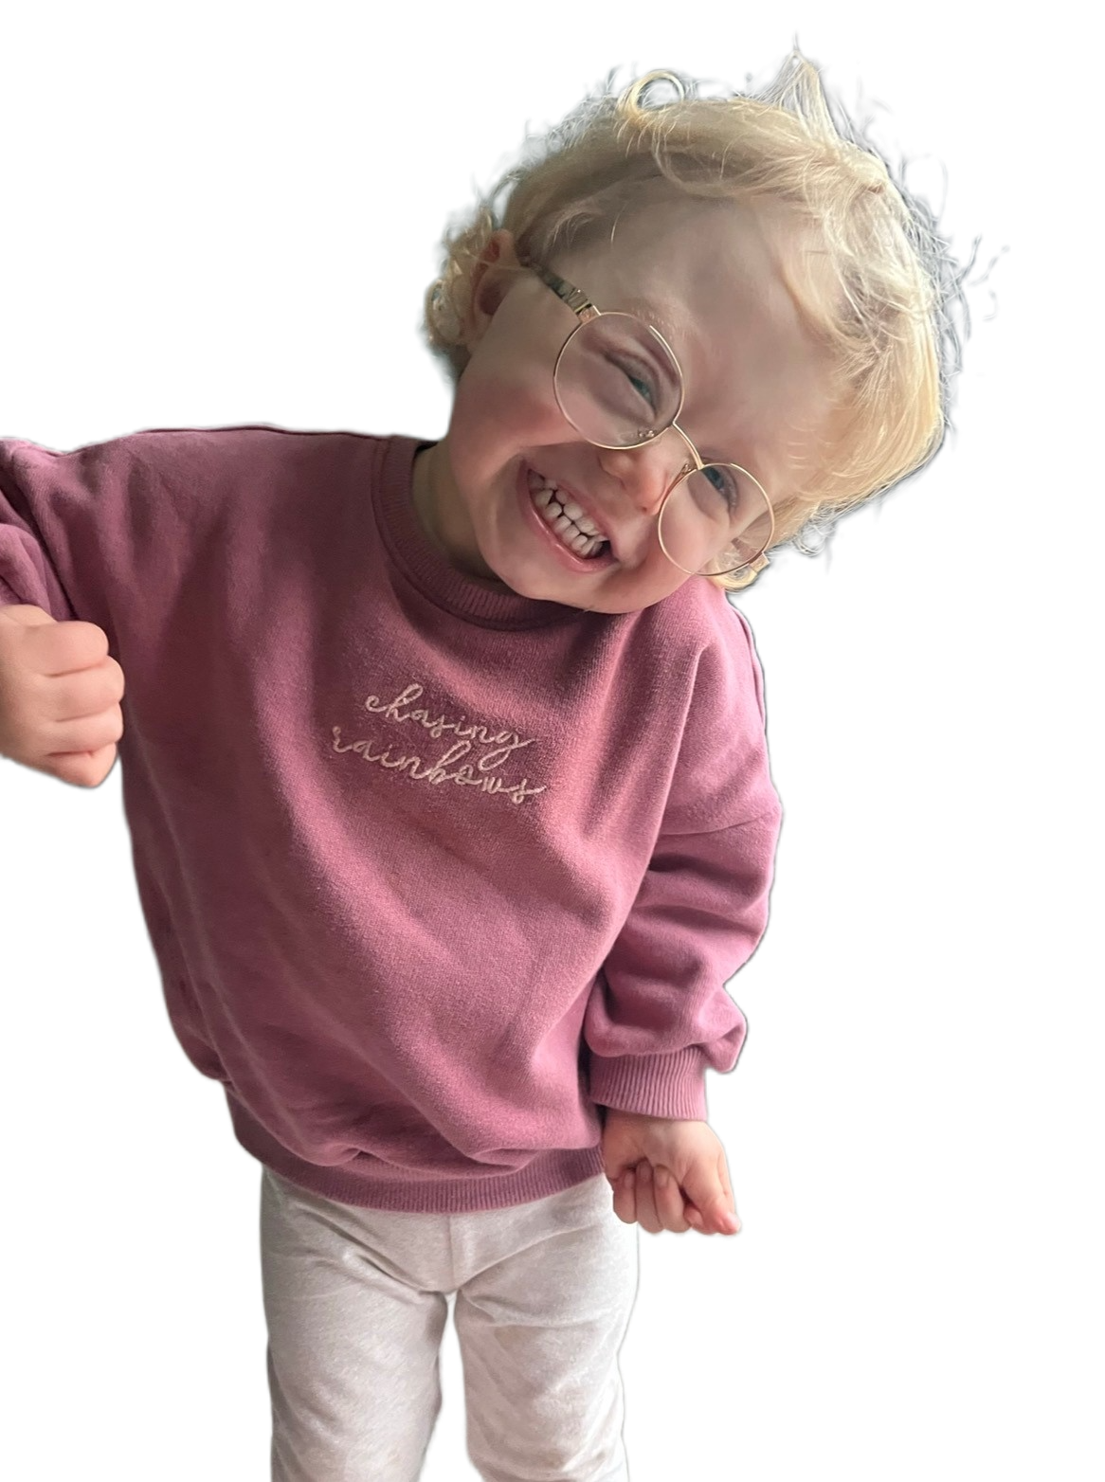
Attention & Executive Skills
Helping children focus, remember and get started
Some children with NF1 may:
✓ Find it difficult to stay focused during an activity
✓ Become distracted by things happening around them
✓ Forget an instruction soon after hearing it
✓ Struggle with instructions containing several steps
✓ Need reminders about what they should be doing
✓ Find it difficult to start or finish an activity independently
✓ Move quickly from one activity to another
✓ Become overwhelmed when there is too much information at once
Rather than asking:
“Why aren't they concentrating?”
Consider asking:
“How can I make this task easier to follow and manage?”
What looks like not listening or not trying may be a child finding attention, memory or organisation difficult.

Slide 9
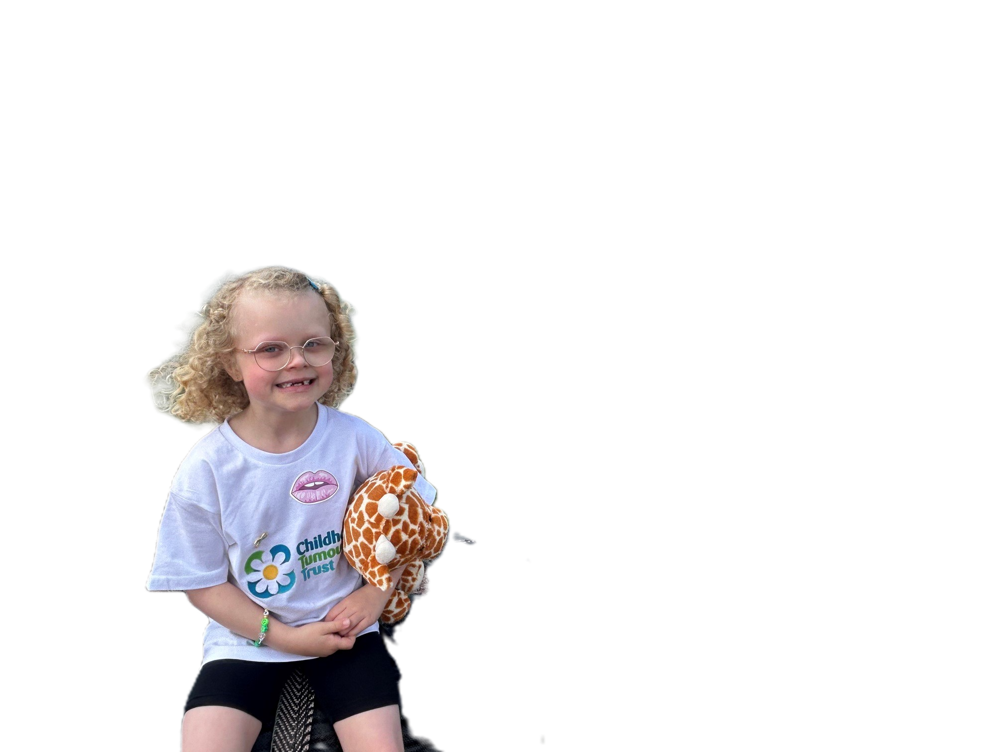
Fatigue, Pain & Medical Appointments
When health affects the Early Years day
Some children with NF1 may:
✓ Tire more quickly than other children
✓ Have days when they have less energy
✓ Experience pain, discomfort or headaches
✓ Need regular hospital appointments or tests
✓ Miss sessions because of appointments or treatment
✓ Find it difficult to settle back into the routine after an absence
✓ Become quieter, emotional or less able to concentrate when tired
✓ Need rest or a quieter activity during the day
Rather than asking:
“Why can't they keep up today?”
Consider asking:
“Could tiredness, pain or their health be affecting them today?”
A child's needs may change from day to day. Flexibility allows them to remain included without expecting them to push through pain or fatigue.

Slide 10
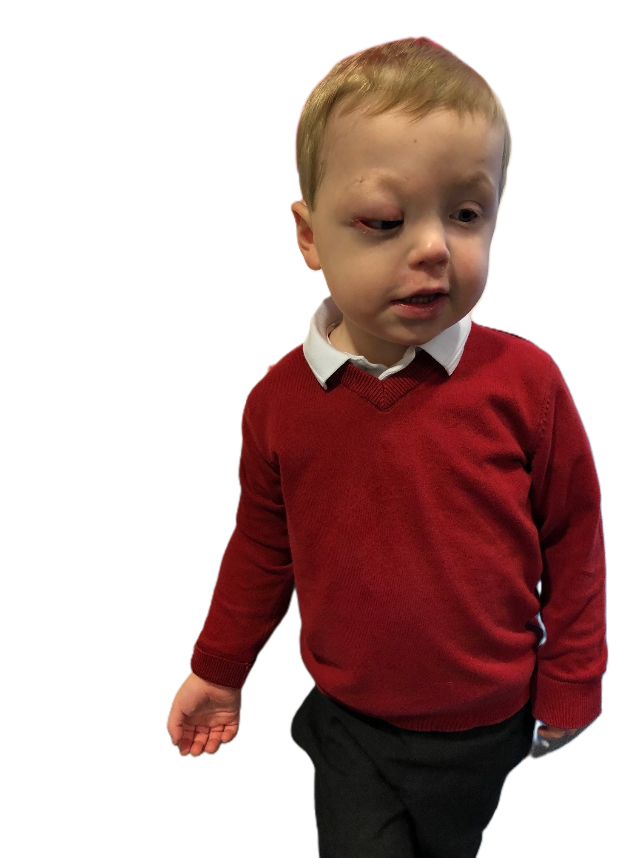
Friendships & Social Development
Helping children feel included and connected
Some children with NF1 may:
✓ Find it difficult to approach other children or join a game
✓ Prefer playing alongside others rather than with them
✓ Find sharing or taking turns difficult
✓ Misunderstand social cues or other children's reactions
✓ Talk at length without noticing when another child wants to speak
✓ Become upset when games do not go as expected
✓ Feel self-conscious if NF1 causes visible differences
✓ Need adult help to build and maintain friendships
.
Rather than asking:
“Why don't they play with the other children?”
Consider asking:
“What support could help this child feel confident and included with their peers?”
Friendship skills do not always develop automatically. Gentle adult support can help a child feel that they belong..

Slide 11
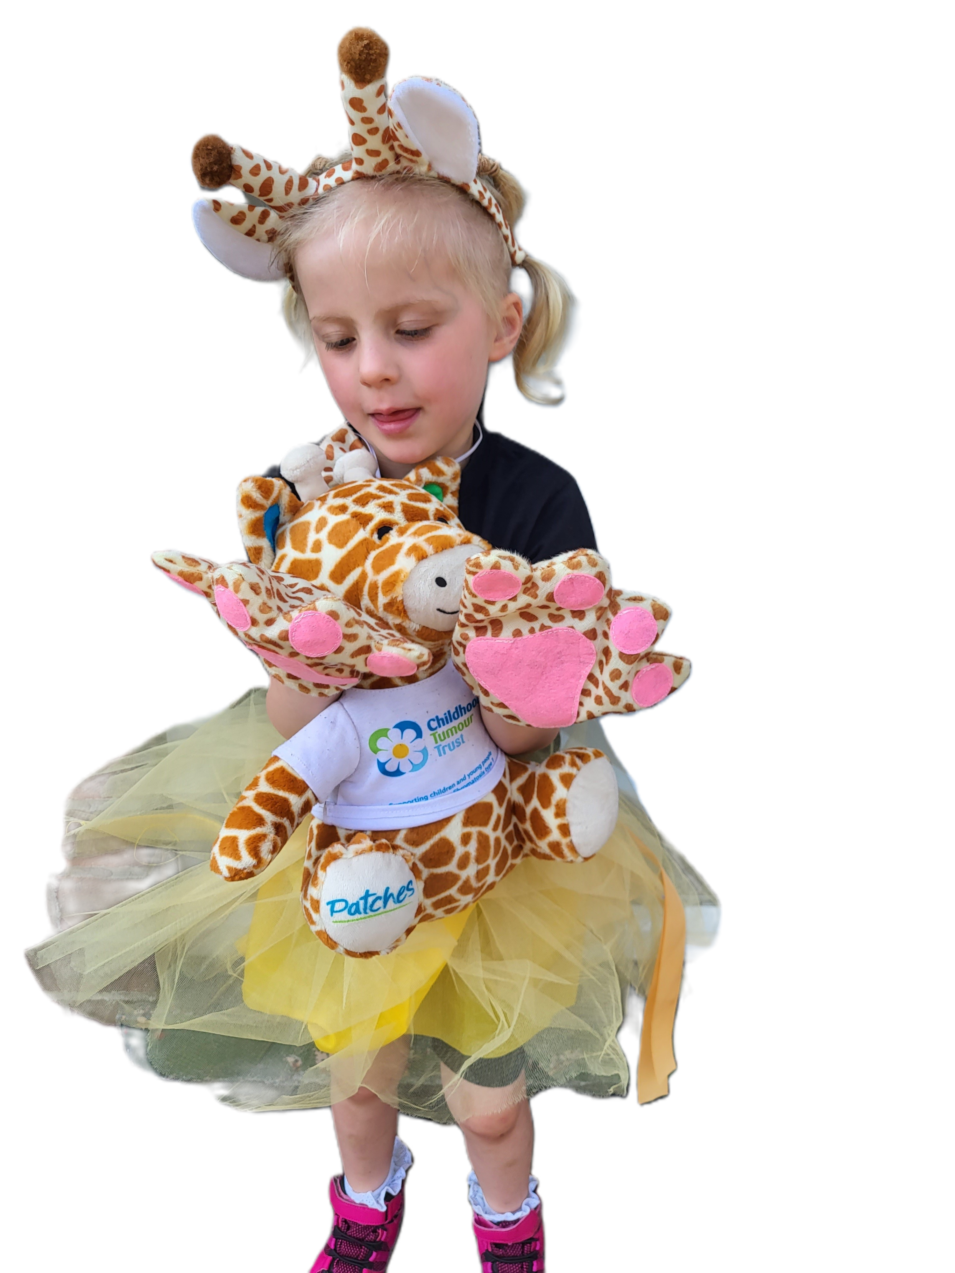
Working with Families
Parents and carers know their child best
Rather than saying to a parent/carer:
“Your child isn’t joining in with physical activities.”
Consider asking:
“We’ve noticed that some physical activities seem more difficult for your child. Is there anything you’ve noticed at home, or anything we can do to make it easier for them to join in?”
Families may be able to tell you:
✓ What their child finds difficult
✓ What helps their child communicate
✓ What works well at home
✓ How NF1 currently affects their child
✓ Whether pain, fatigue or sleep is affecting them
✓ About upcoming appointments or treatment
✓ About changes they have noticed in their child's development
✓ What their child is particularly good at or enjoys
.
Early Years practitioners and families see different parts of a child's life. Bringing those observations together can help identify needs and support earlier.

Slide 12
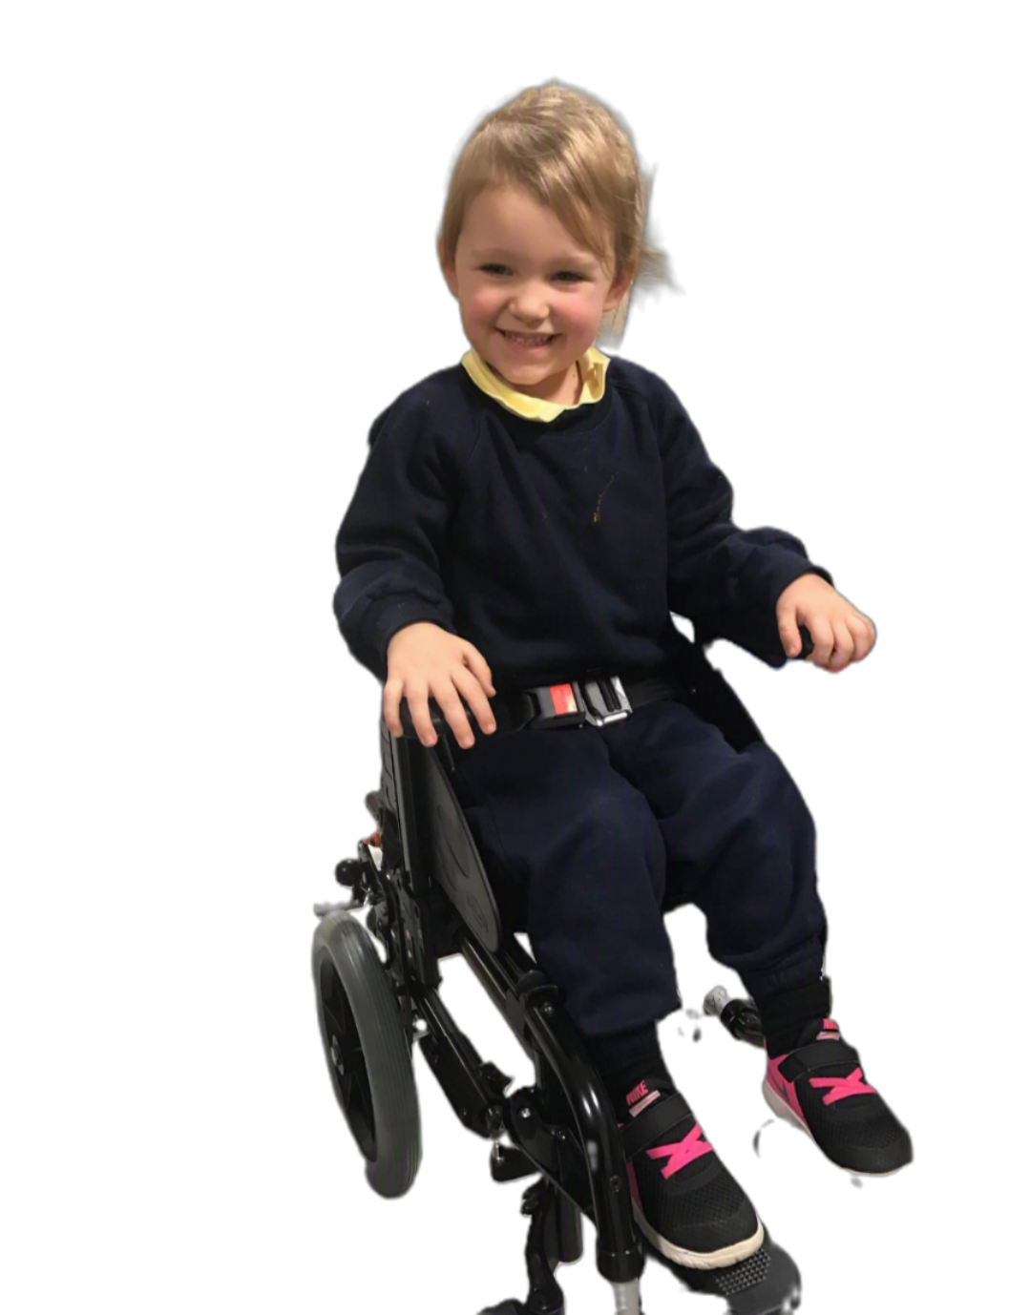
When Additional Support May Help
Recognising when a child may need more support
Rather than thinking:
“They will probably catch up.”
Consider asking:
“Should we discuss what we're seeing with the SENCO and family?”
You may notice persistent difficulties with:
✓ Speech, language or communication
✓ Attention or concentration
✓ Fine or gross motor development
✓ Learning new skills
✓ Social interaction or friendships
✓ Managing emotions or changes in routine
✓ Independence with everyday tasks
✓ Accessing activities alongside their peers
Do not wait for a child to fail before offering support. Early recognition and appropriate intervention can make a lasting difference

Slide 13
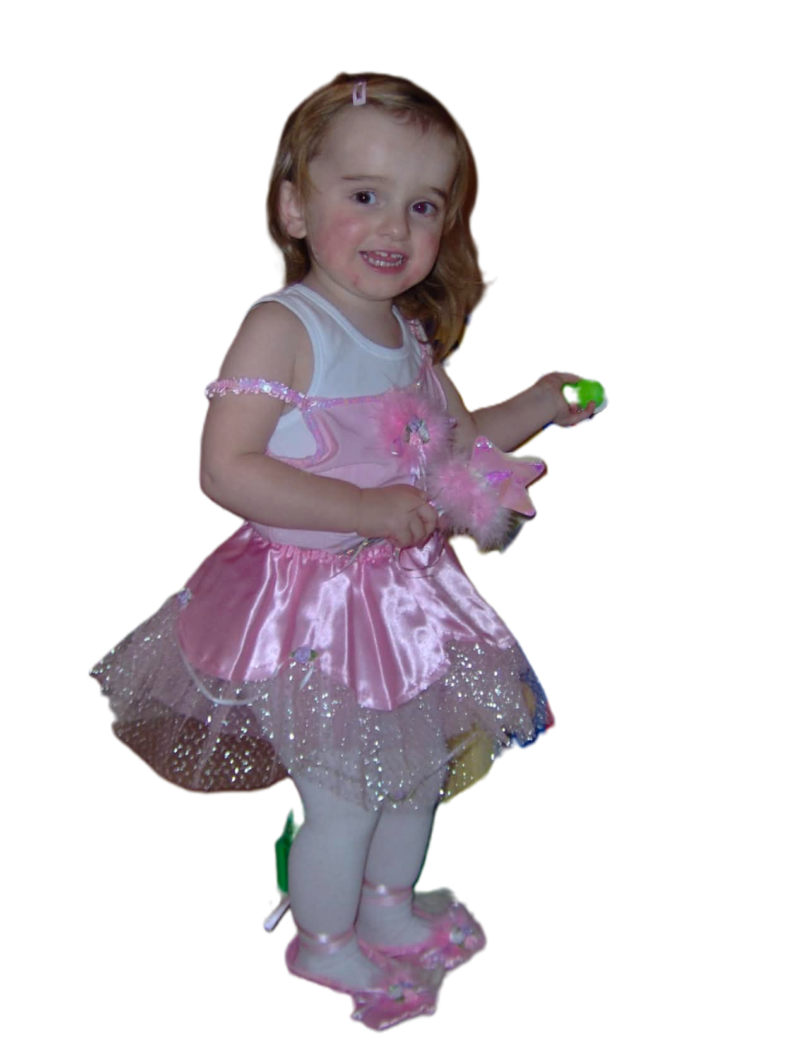
Strengths & Potential
See the whole child, not just NF1
You may notice persistent difficulties with:
A child with NF1 may be:
✓ Creative and imaginative
✓ Curious and keen to learn
✓ Kind and caring
✓ Funny and sociable
✓ Determined and persistent
✓ Talented in particular areas
✓ Full of ideas and enthusiasm
✓ Capable of much more than others may assume
Rather than asking:
“What can't this child do?”
Consider asking:
“What are they good at, and how can we build on it?”
Having NF1 does not determine a child's potential. Support their strengths and aspirations rather than limiting them because of their diagnosis.

Slide 14
Meet Emily
What support can look like in practice
Loves dinosaurs and imaginative play
✓ Takes longer to process group instructions
✓ Sometimes finds it difficult to join other children's games
✓ Finds pencil control tiring
✓ Becomes tired towards the end of the day
✓ Needs reassurance when routines change
What helps Emily?
✓ Simple instructions and visual prompts
✓ Extra time to respond
✓ Support joining group play
✓ Short breaks when she becomes tired
✓ Adults recognising and building on the things she loves
fd
Rather than asking:
“How do we manage Emily's NF1?”
Consider asking:
“What does Emily need from us to participate, develop and thrive?”
Characters created based on different lived experiences of NF1

Slide 15

What Every Early Years Practitioner Should Remember
Small changes now can have a lasting impact
fd
REMEMBER
✓ Every child with NF1 is different
✓ Difficulties may not always be obvious
✓ Behaviour may be communicating an unmet need
✓ Early developmental differences should not simply be dismissed
✓ Listen to parents and carers
✓ Work closely with the SENCO and other professionals
✓ Keep expectations high while providing appropriate support
✓ Celebrate the child's strengths, progress and individuality
Ask yourself:
“What can we put in place now that will help this child as they move through education?”
Getting the right understanding and support in place from the beginning can make a lifelong difference for a child with NF1.

Slide 16
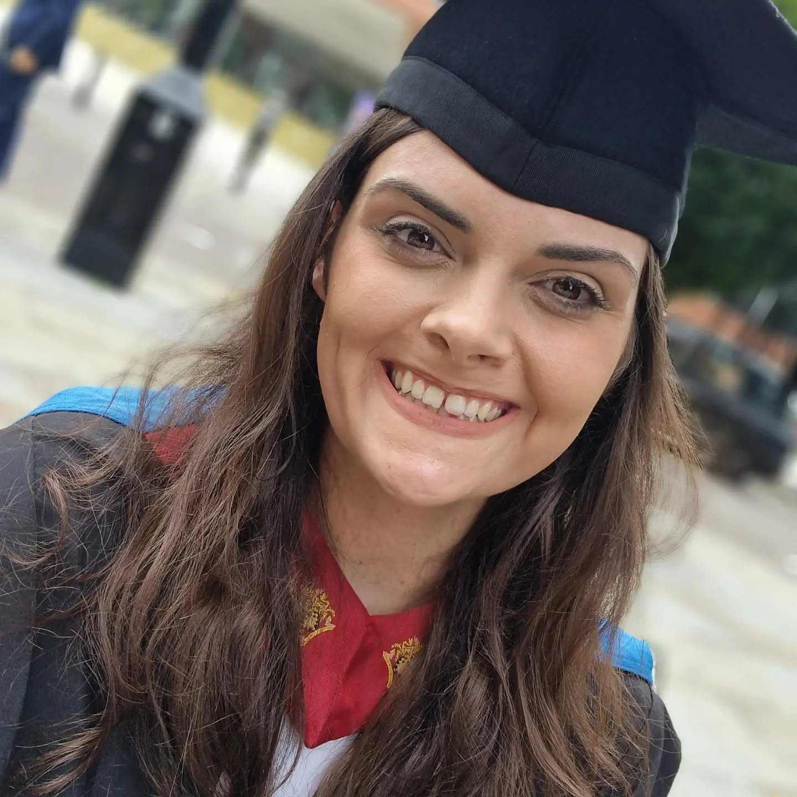
Real Life Story
The difference the right support can make
Nicole
At age 6, she couldn't write her own name.
✓ She struggled with learning from an early age
✓ She was excluded from PE because of difficulties associated with NF1
✓ She was told she was unlikely to achieve academically
✓ She left school with just one GCSE
But that wasn't the end of her story.
At college, she finally received the right support and encouragement.
✓ She achieved a Sports Diploma
✓ She discovered how she learned best
✓ Her confidence and aspirations grew
✓ She went on to university
✓ She graduated with a degree in Graphic Design Engineering

Slide 17


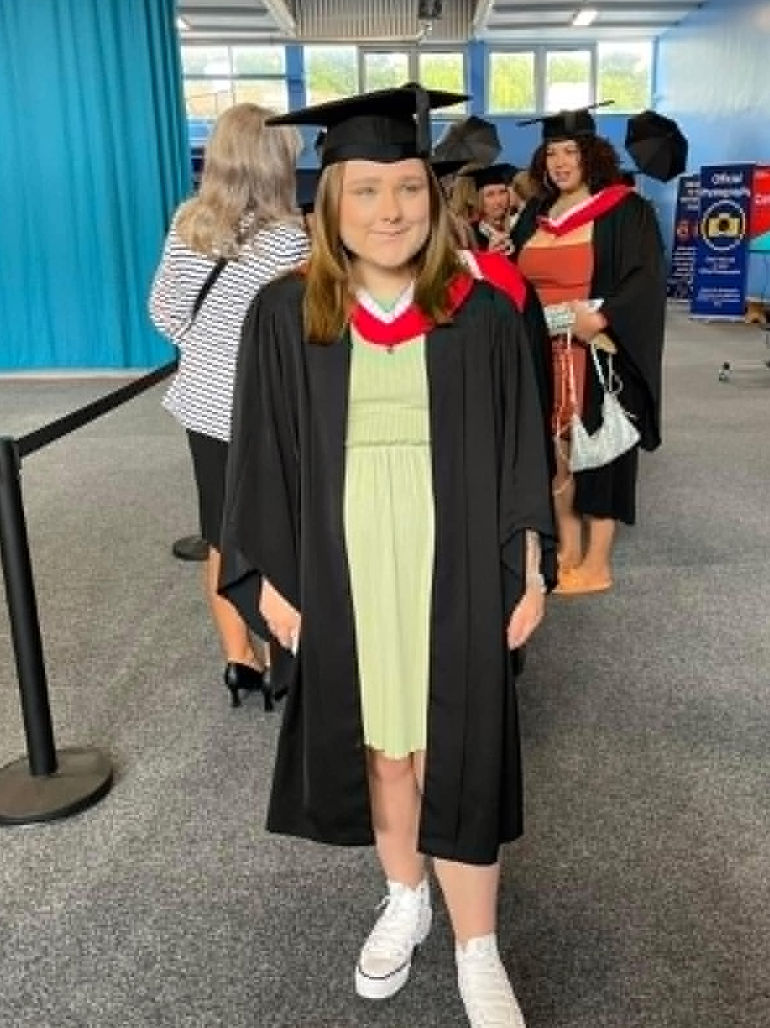
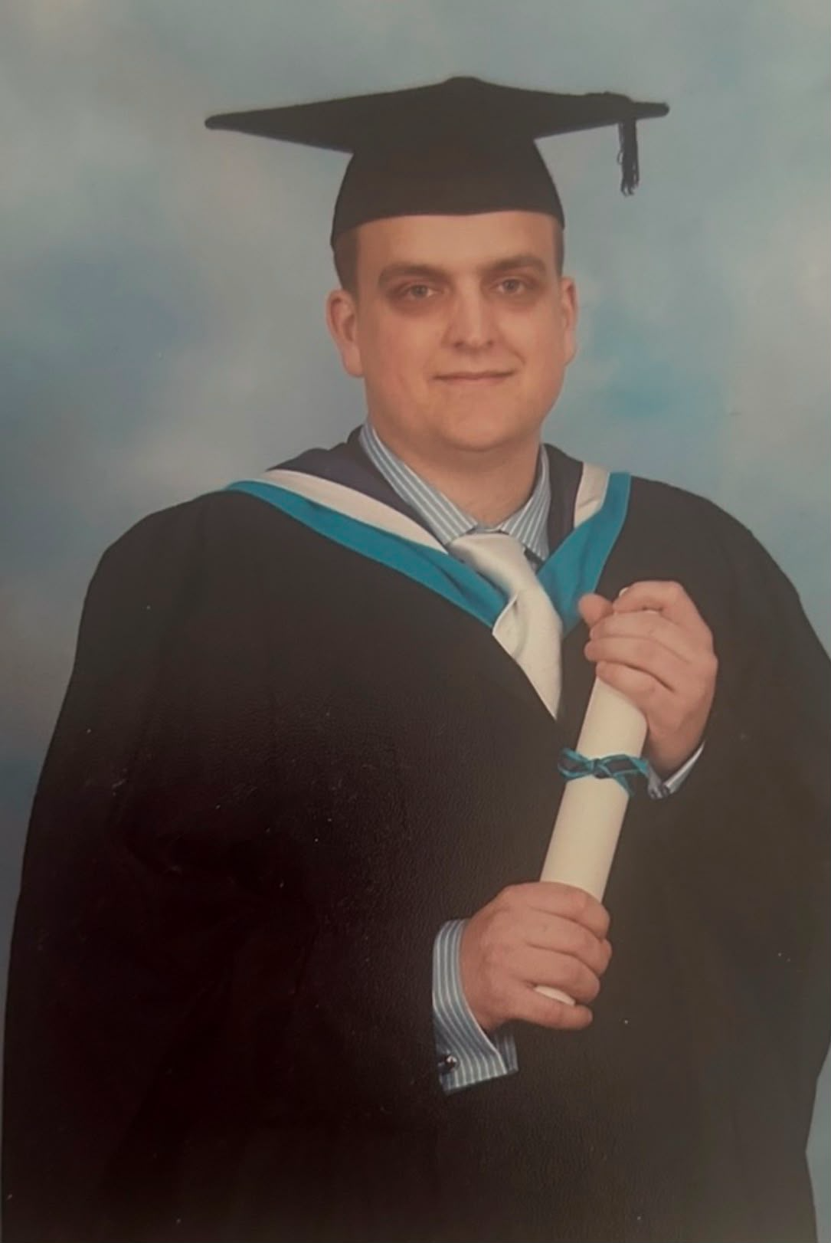
And she is not alone……………….
Canva-stye visual space
Early support may not change NF1, but it can change the journey — helping children build confidence, overcome barriers and reach their potential.

Slide 18


Success looks different for everyone
The goal is opportunity, not one particular destination
Not every child with NF1 will want to go to university — and they don't need to.
With the right understanding and support from an early age, we can help children:
✓ Discover what they enjoy and what they are good at
✓ Develop confidence in their own abilities
✓ Build the skills they need for greater independence
✓ Explore college, apprenticeships, university, employment or other pathways
✓ Make choices based on what they want to do, rather than what others assume they can do
Early support isn't about deciding a child's future. It's about giving them the best possible chance to have choices about their future.
Early support isn't about deciding a child's future. It's about giving them the best
possible chance to have choices about their future.

Slide 19
Thank you
Notes:
Introduce the session as a teacher-focused resource. Explain that the aim is not to make teachers medical experts, but to help them recognise how NF1 may affect learning, confidence, attendance and participation. Emphasise that NF1 looks different for every young person, so the most helpful approach is curiosity, flexibility and collaboration with the student, family and SENCO.

