Slide 1


Teacher Resource Storyboard
Understanding
Neurofibromatosis Type 1 (NF1)
NF1
Understand
Support
Include
Supporting Students in Secondary Schools
A teacher-focused storyboard presentation with detailed speaker notes for use in school awareness training.
Made by Students (Lauren Gowans and Ramneek Sandhu) at Manchester Metropolitan University for the Childhood Tumour Trust
Notes:
Introduce the session as a teacher-focused resource. Explain that the aim is not to make teachers medical experts, but to help them recognise how NF1 may affect learning, confidence, attendance and participation. Emphasise that NF1 looks different for every young person, so the most helpful approach is curiosity, flexibility and collaboration with the student, family and SENCO.

Slide 2

What is NF1?
A simple explanation teachers can remember
Neurofibromatosis Type 1, or NF1, is a genetic condition a person is born with.
It can affect the skin, nerves, bones, vision, learning and emotional wellbeing.
It is highly variable: one student may have very few difficulties, while another may need regular support.
NF1 is not caused by anything the student or family did, and it is not contagious.
Teachers do not need to diagnose NF1; their role is to notice barriers, respond supportively and work with the right people.
Key message: NF1 is a lifelong condition, but the student’s school experience can be made much easier through understanding and reasonable adjustments.
Notes:
Say that NF1 is a genetic condition, but avoid making the explanation overly medical. Teachers mainly need to know that it can affect several areas of a young person's life, including learning and wellbeing. Highlight variability: two students with NF1 may present completely differently. One may be academically confident and only need understanding around appointments; another may need help with attention, organisation, fatigue or social confidence. Make clear that NF1 is not contagious and should never be treated as something that separates the student from their peers.

Slide 3

How NF1 may affect learning
Common classroom-related areas to be aware of
Attention
Processing speed
NF1 can show up in different ways
May find it difficult to stay focused, especially during long explanations or independent tasks.
May understand the lesson but need longer to take in instructions, answer questions or complete work.
These are possible areas to notice — not a checklist every student will match.
Executive functioning
Visual-spatial skills
May struggle with planning, organisation, remembering equipment, starting tasks or managing deadlines.
May find diagrams, copying from the board, handwriting layout, maths or maps more challenging.
🧠
Reading, writing & maths
Fatigue, pain & sleep
Some students may have specific difficulties with literacy, numeracy, spelling or written expression.
Some children with NF1 experience fatigue, headaches, pain or sleep difficulties, which may affect concentration, behaviour and learning during the school day.
Teacher Reflection
Key Message
Rather than asking:
"How can this student catch up?"
Consider asking:
"What adjustments will help this student learn successfully?"
A student with NF1 may not be behind simply because they have missed school. Many children with NF1 learn differently and benefit from teaching strategies and support that meet their individual learning needs.
Notes:
Explain each area slowly and link it to real classroom behaviour. For example, a student who seems distracted may actually be struggling with attention or processing speed. A student who forgets homework may not be careless; they may have executive functioning difficulties. A student who avoids writing may be struggling with fine motor skills, fatigue, or visual-spatial demands. Stress that these difficulties are not signs of laziness or lack of motivation. Teachers can reduce barriers by breaking tasks down, offering reminders, and checking understanding privately.
It is important to remember that although hospital appointments and surgery can result in missed learning, many students with NF1 also experience underlying neurodevelopmental differences that affect how they learn. This means that simply giving more work to 'catch up' or expecting extra time alone to solve the problem may not be enough. Instead, teachers should consider what adjustments and teaching strategies will help the student access learning successfully.One of the most common misconceptions is that students with NF1 only fall behind because they have missed school due to surgery or hospital appointments. Although absences can certainly affect learning, they are often only part of the picture. Many students with NF1 experience underlying learning differences, such as difficulties with attention, processing speed, executive functioning or visual-spatial skills. This means that simply expecting a student to 'catch up' by completing missed work is often not enough. Instead, teachers should ask what adjustments or teaching strategies will help the student access learning successfully.
Children with NF1 have a higher prevalence of neurodevelopmental differences, including ADHD, autism spectrum disorder and other learning difficulties, than the general population. Not every child with NF1 will experience these difficulties, but teachers should be aware that they are more common and may influence how a student learns, communicates and engages in school.
Having learning differences does not mean a student cannot achieve highly. Many young people with NF1 go on to complete college, university degrees and successful careers when they receive the right support. The aim is not simply to help students catch up, but to help them learn in ways that work for them.

Slide 4

yuuiky
What teachers might notice
Possible signs in everyday school life
The student understands verbally but produces less written work than expected.
They may need instructions repeated or written down before they can begin.
They may appear tired, overwhelmed, quiet, anxious or withdrawn on some days.
They may miss lessons due to medical appointments and then find it hard to catch up.
They may avoid PE, group work, changing rooms or presentations because of pain, confidence or visible differences.
They may be socially vulnerable, misread peer cues, or be targeted by teasing or bullying.
Some pupils may have delayed speech, language or communication skills, making it more difficult to express ideas, follow complex instructions or participate confidently in discussions.
Avoid assuming behaviour is deliberate. Ask: “What support would help this student access the same learning?”
Notes:
This slide is about translating NF1-related needs into things teachers may actually see. Give examples: slow written work, unfinished tasks, forgotten equipment, low confidence, reluctance to participate, or tiredness after appointments. Emphasise that teachers should not jump to negative labels such as lazy, rude, dramatic or disorganised. Instead, they should ask what barrier might be underneath. Encourage staff to record patterns and speak to the SENCO if concerns persist.

Slide 5

Social and emotional impact
Why emotional safety matters as much as academic support
Students may feel different because of café-au-lait marks, visible lumps, scarring, height, pain, or needing extra support.
They may worry about classmates asking personal questions or making comments.
Missing lessons for appointments can make students feel behind, isolated or embarrassed.
Repeated difficulties with learning can affect confidence, motivation and self-esteem.
Some students may hide their needs because they do not want to stand out.
A calm, kind teacher response can reduce shame and help the student feel safe asking for help.
Visual idea:
Use a calm classroom, teacher, student or simple icon illustration here.
Inclusion is not only about access to work; it is also about feeling respected, believed and understood.
Notes:
Explain that NF1 can affect identity and confidence, especially during adolescence when young people are very aware of appearance and peer judgement. Some students may not want the class to know about their condition. Others may be open to sharing simple information. This should always be guided by the student and family. Remind teachers that small moments matter: a private check-in, flexible support after absence, or quickly stopping teasing can have a large impact on wellbeing.

Slide 6


Recognising when additional support may help
When additional support may be needed
If a student with NF1 experiences any of the following, it may be helpful to discuss your observations with the school's SENCO:
Persistent learning difficulties
Significant attention or executive functioning challenges
Difficulties accessing the curriculum
Emotional wellbeing concerns
Repeated absences affecting learning
Some pupils may benefit from
✓ Reasonable classroom adjustments
✓ Targeted learning support
✓ SEND assessment
✓ Education, Health and Care Plan (EHCP), where appropriate
✓ Referral to an Educational Psychologist (where appropriate)
Visual idea:
A
Remember: Not every student with NF1 will require additional educational support or an EHCP. Decisions should always be based on the individual student's strengths, needs and experiences. Support should reflect how a student learns, not simply how much school they have missed.
Notes:
Not every student with NF1 will require an EHCP. However, some students have learning or physical needs that mean an EHCP provides additional coordinated support. Teachers should discuss concerns with the SENCO rather than trying to make this decision themselves.

Slide 7

Strengths-based approach
Support the student without defining them by NF1
Start with the young person’s strengths, interests, goals and preferred ways of learning.
Ask what helps them feel confident, not only what they find difficult.
Give meaningful roles in group work so they are seen as capable by peers.
Use praise that is specific: effort, problem-solving, persistence, kindness or creativity.
Avoid overprotecting the student; high expectations and appropriate support should work together.
Let the student have a voice in decisions about seating, help, catch-up work and disclosure.
Remember
Many young people with NF1 go on to achieve excellent GCSEs, A Levels, university degrees and successful careers when they receive the right educational support.
.
Helpful question: “What do you already do well, and what would make school feel easier?”
Notes:
Make clear that a teacher version should not present the student as fragile or defined by difficulties. NF1 can bring challenges, but the student is still a whole person with strengths, interests and ambitions. A strengths-based approach helps protect self-esteem. Teachers can ask the student what works for them and avoid making assumptions. Emphasise that support should empower the student, not make them feel singled out.
Having NF1 does not limit potential. High expectations should always remain. The goal is to remove barriers, not lower aspirations.

Slide 8

Classroom strategies: instructions and tasks
Small changes that reduce cognitive load
Give instructions in short, clear steps rather than long sequences.
Use written instructions, checklists or task boards so the student does not rely only on memory.
Check understanding privately by asking the student to explain the first step back to you.
Provide worked examples before independent practice.
Break large assignments into mini-deadlines with reminders.
Allow extra processing time before expecting an answer, especially in whole-class questioning.
These strategies are useful for many learners, so they can be built into normal teaching practice.
Notes:
This slide should feel practical and easy for teachers to use. Explain that many NF1-related learning barriers are linked to attention, memory, processing speed and organisation. Reducing cognitive load can help. Rather than saying “listen carefully,” provide steps visually. Rather than asking “do you understand?” ask “what is the first thing you are going to do?” Encourage teachers to normalise these supports so the student does not feel singled out.

Slide 9
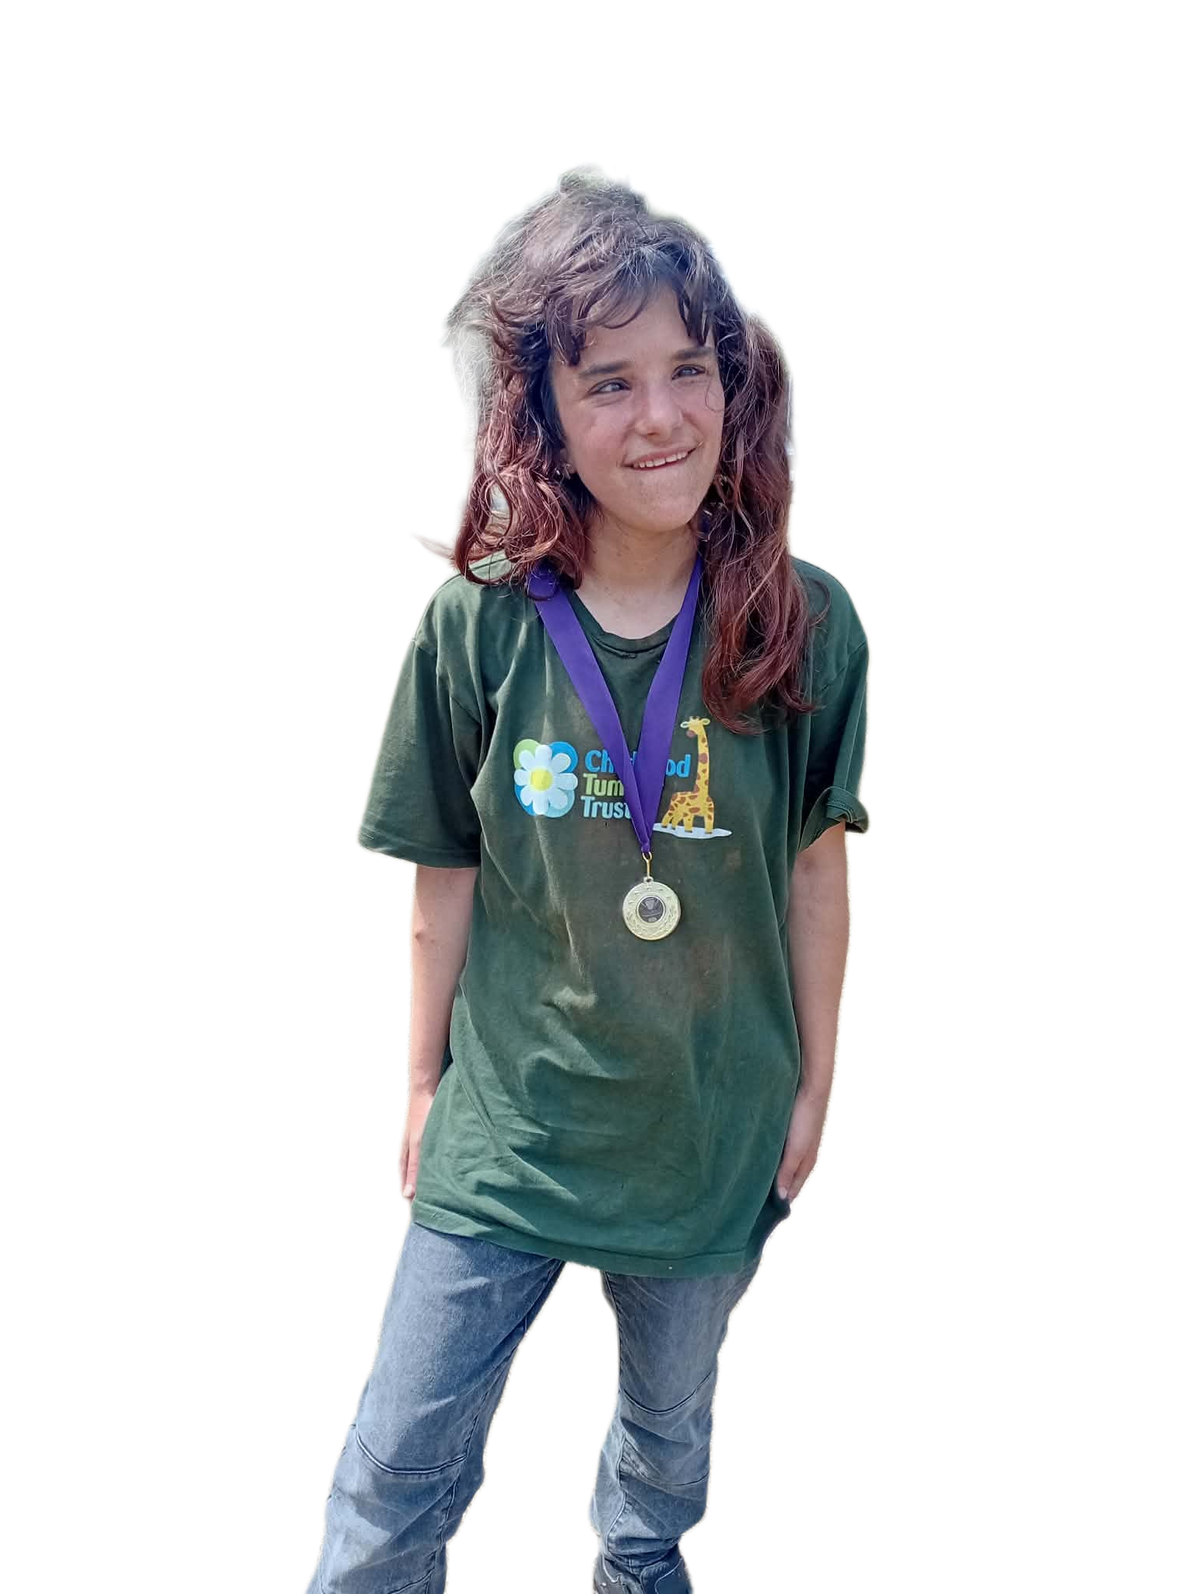
Classroom strategies: access and flexibility
Supporting attendance, fatigue, pain and confidence
Plan catch-up work after appointments: identify the most important content rather than giving everything at once.
Allow rest breaks, movement breaks or a quiet space if fatigue, pain or overwhelm affects concentration.
Consider seating: good view of the board, reduced distractions and easy teacher check-ins.
Offer alternatives when needed, such as typing instead of handwriting or presenting to a smaller group.
Be flexible with PE or practical tasks if the student has pain, mobility concerns or medical guidance.
Communicate changes early because uncertainty can increase anxiety and organisation difficulties.
Flexibility does not mean lowering standards; it means removing unnecessary barriers.
Notes:
Explain that attendance and fatigue can make school harder for students with NF1. If they miss a lesson, they may need a structured catch-up plan instead of a pile of work. Flexibility should be purposeful and agreed with the SENCO or family where needed. Give examples: a student may type longer answers, receive slides in advance, sit near the front, or have a reduced catch-up workload focused on core learning outcomes. Make clear this is about access, not special treatment.

Slide 10

Responding to questions and comments
How to protect privacy while building understanding
Do not share a student’s diagnosis with the class unless the student and family have agreed.
If classmates ask questions, use general language: “Everyone’s body and health needs are different.”
Challenge unkind comments immediately and calmly.
Avoid making the student explain their condition unless they choose to.
If the student wants to share, help them plan what they are comfortable saying.
Use PSHE, tutor time or inclusion lessons to teach empathy without identifying one student.
With the agreement of the student and if their family are comfortable, consider providing age-appropriate information about NF1 through tutor time, PSHE lessons or assemblies. Increasing awareness can reduce misconceptions, encourage empathy and help create a more inclusive school environment.
Always one!
Privacy first: the student should have control over what others know about their condition.
Notes:
This is important because teachers may want to educate the class but must protect confidentiality. Explain that the student's diagnosis is personal information. If comments happen, the teacher can respond without revealing anything: “We do not comment on people’s bodies,” or “Everyone deserves respect.” If the student wants to share, plan it carefully with the family and SENCO. The goal is to reduce stigma while preserving dignity and choice.
Some schools choose to raise awareness of NF1 through PSHE lessons, tutor time or assemblies. This can help classmates understand the condition, reduce myths and encourage empathy. However, this should only be done with the agreement of the student and their family. Some young people are happy to share their experiences, while others prefer to keep their diagnosis private. Their wishes should always be respected.

Slide 11
Example students with NF1
Olivia, aged 13
Olivia struggles with self-confidence and anxiety due to her café-au-lait marks and tumours. She has dealt with bullying in the past due to this.
She can find school daunting and often has anxiety surrounding her checkup appointments, which are to check for any changes in her condition.
Despite this, Olivia loves to create art and often finds it is a good distraction from worries that she is facing.
Characters created based on different lived experiences of NF1

Slide 12

Example students with NF1
Jack, aged 15
Jack has also missed school for appointments but is sitting his GCSEs at the end of the year so is worried about his grades.
He loves playing football and can find it a welcome distraction to any worries he is facing with NF1
He can find it difficult to concentrate in lessons which he can find frustrating and tiring, adapting learning for him is vital to keep him engaged and focused.
With additional support Jack will be able to thrive in his GCSEs and finds learning easier.
Characters created based on different lived experiences of NF1

Slide 13

Working with parents, carers and SENCO
A joined-up approach prevents support from becoming inconsistent
Ask parents/carers what has helped before and what current concerns they have.
Work collaboratively with the SENCO, parents/carers and other professionals involved in the child's care, such as speech and language therapists, educational psychologists and healthcare professionals.
Keep communication practical: attendance, workload, fatigue, peer issues, homework and exam arrangements.
Review support regularly because NF1-related needs can change over time.
Include the student in age-appropriate discussions so support feels collaborative rather than imposed.
Record agreed strategies so all teachers respond consistently.
.
Consistency matters: support works best when all staff understand the same plan.
Notes:
Explain that the class teacher is not expected to manage this alone. The SENCO can coordinate support, assessments and communication across subjects. Parents and carers often know the student’s needs very well, especially around fatigue, appointments and emotional impact. The student should also be included because they can say what feels helpful or embarrassing. Consistency reduces stress, because the student does not have to keep explaining themselves to every teacher.

Slide 14
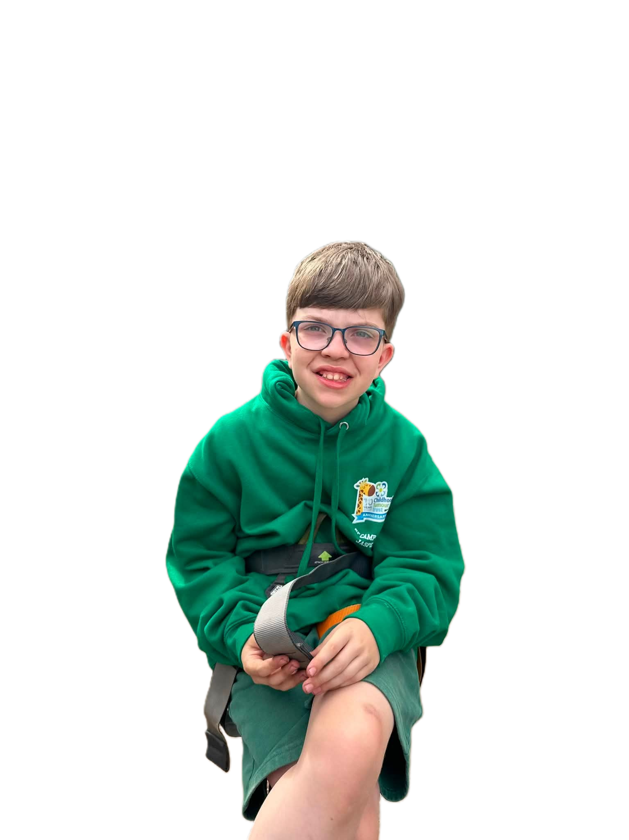
Example teacher response
Turning awareness into everyday practice
Instead of: “You need to try harder to finish.”
Try: “I can see you understand this. Let’s choose the first two questions and build from there.”
Instead of: “You were absent, so catch up everything tonight.”
Try: “Here are the key points you missed. We’ll prioritise these first.”
Instead of: “Why are you not joining in?”
Try: “Would it help to take a smaller role today or work with one trusted partner?”
Instead of : "You just need to catch up.„
Try: "Let's work together to identify what support will help you access the learning."
.
Supportive language reduces shame and keeps expectations realistic.
Notes:
Use this slide to model how teachers can change their language. The aim is not to excuse everything but to respond in a way that keeps the student engaged. Supportive language shows the student that the teacher believes them and is willing to problem-solve. This can prevent withdrawal, anxiety and conflict. Encourage teachers to use calm, private conversations rather than public correction whenever possible.

Slide 15

Key takeaways for teachers
What to remember after the session
NF1 affects students differently, so individualised support is essential.
Learning, attention, organisation, fatigue and emotional wellbeing can all be affected.
Behaviour may be communication: look for the barrier before assuming the student is not trying.
Small classroom adjustments can make a major difference.
Protect the student’s privacy and respond firmly to teasing or bullying.
Work with the student, family, SENCO and wider school team.
Keep expectations high, but make the route to success accessible.
The goal is not to make NF1 the centre of the student’s identity. The goal is to make school feel safe, fair and achievable.
Notes:
Summarise the whole presentation. Reinforce that teachers do not need to know everything about NF1 to be helpful. They need to listen, notice barriers, adapt teaching where appropriate, and work with others. Emphasise high expectations with reasonable adjustments. End with the idea that a supportive teacher can have a long-lasting effect on the student’s confidence and school experience.

Slide 16

What every Teacher should remember
Students with NF1 are capable of achieving extraordinary things.
Our role is not to expect them to overcome unnecessary barriers alone.
Our role is to provide the understanding, adjustments, and encouragement that allow them to reach their potential.
🔗
Visual idea:
A teacher standing beside a student looking at a bright future (e.g. graduation cap, books, stars, pathway).
Support today → Success tomorrow
Every student deserves the opportunity to feel understood, included and able to thrive.
Notes:
As we come to the end of this presentation, I'd like to leave you with one final thought.
Having NF1 does not define a student's ability or future potential. Many children and young people with NF1 go on to achieve excellent GCSEs, A Levels, university degrees and successful careers.
As Vanessa Martin from the Childhood Tumour Trust shared, many students are sometimes told that they simply need to 'catch up' after missing school due to hospital appointments. While attendance can certainly affect learning, many students with NF1 also experience genuine learning differences. Providing more work or expecting them to catch up independently is often not enough.
Instead, our role as educators is to recognise how each student learns best and to provide the appropriate support, adjustments and encouragement that allow them to succeed.
Every student with NF1 is unique. By creating an inclusive classroom, maintaining high expectations and working collaboratively with families and support staff, we can help ensure that every young person has the opportunity to reach their full potential.

Slide 17

A REAL-LIFE STORY
The difference the right support can make
At six years old, she couldn't write her own name.
She struggled throughout school and was excluded from PE because of difficulties associated with NF1.
She was told she wasn't going to get anywhere.
She left school with just one GCSE.
Then she went to college and received the right support.
She achieved a Sports Diploma.
She went on to university and graduated with a:
Degree in Graphic Design Engineering
Her ability hadn't suddenly changed. What changed was the support around her — and her story is not an isolated one.

Slide 18





SHE IS NOT ALONE
Don't limit a child's future
These young people all have NF1
And they were all told they wouldn’t achieve academically.
Their journeys have been different, but they show why difficulties during childhood should never be used to predict what a child will achieve in the future.
Support their potential instead of limiting it.
Support their potential instead of limiting it.

Slide 19


Success looks different for everyone
The goal is opportunity, not one particular destination
Not every child with NF1 will want to go to university — and they don't need to.
With the right understanding and support from an early age, we can help children:
✓ Discover what they enjoy and what they are good at
✓ Develop confidence in their own abilities
✓ Build the skills they need for greater independence
✓ Explore college, apprenticeships, university, employment or other pathways
✓ Make choices based on what they want to do, rather than what others assume they can do
Early support isn't about deciding a child's future. It's about giving them the best possible chance to have choices about their future.
Early support isn't about deciding a child's future. It's about giving them the best
possible chance to have choices about their future.

Slide 20

Further information
Resources and next steps
Childhood Tumour Trust: support for children, young people and families affected by NF1.
NHS: overview of NF1 symptoms, diagnosis and support.
Nerve Tumours UK: school guidance and information for teachers.
School SENCO: first point of contact for learning support and reasonable adjustments.
Parents/carers and the student: key experts on how NF1 affects daily school life.
www.childhoodtumourtrust.org.uk
Notes:
Close by directing teachers to further support. Explain that the presentation is an introduction and should be used alongside school processes. Encourage teachers to speak to the SENCO if they are supporting a student with NF1 or if they notice learning, attendance or wellbeing concerns. Thank them for taking time to learn about a rare condition and for helping make school more inclusive.

Slide 21
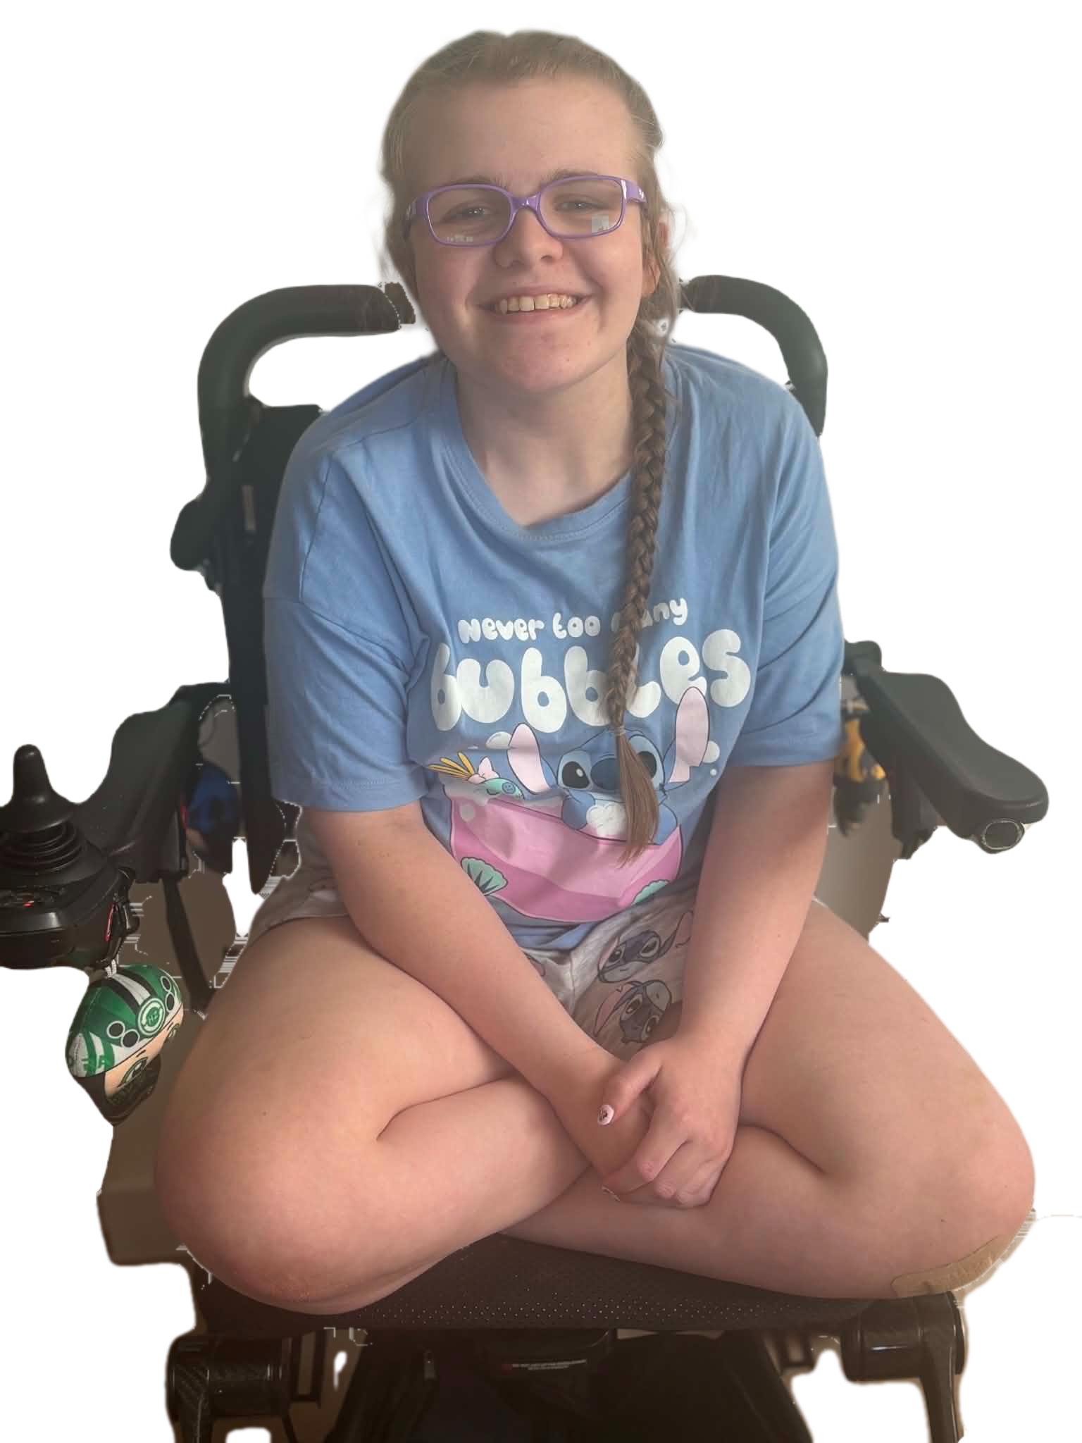
Thank you for Listening!
Made by Students (Lauren Gowans and Ramneek Sandhu) at Manchester Metropolitan University for the Childhood Tumour Trust
Notes:
Introduce the session as a teacher-focused resource. Explain that the aim is not to make teachers medical experts, but to help them recognise how NF1 may affect learning, confidence, attendance and participation. Emphasise that NF1 looks different for every young person, so the most helpful approach is curiosity, flexibility and collaboration with the student, family and SENCO.

Slide 22
Evidence base used for content
NHS. Neurofibromatosis Type 1 overview: symptoms, diagnosis and school support.
Childhood Tumour Trust. NF1 information and support for children, young people and families.
Nerve Tumours UK. Support for teachers and iNForm your School guidance.
Children’s Tumor Foundation. NF1 guide for educators and learning resources.
GeneReviews / NCBI. Neurofibromatosis 1 clinical overview.
Notes:
This slide lists the evidence base used to make the content accurate and appropriate,

